Slide 1
Thankful for Chemistry

Slide 2
Station #1: Stuffed 1
Before stuffing the turkey, you are enlisted to help make the stuffing for Thanksgiving dinner. Rather than using whole crackers, you help your family break them apart to get pieces just right for the recipe. The cracker pieces also need to be soaked in water to achieve the right texture for stuffing.
Change in crackers?
Change in iodine?
Claim: Physical and/or Chemical?

Slide 3
Station #2: Aunt Connie’s Upset Stomach
Before Thanksgiving dinner is suppose to start, Aunt Connie is complaining of an upset stomach from eating some…ok a lot…of leftover Halloween candy the night before. Your mom heads to the medicine cabinet and finds some Milk of Magnesia (used to help with upset stomach, heartburn, and indigestion by neutralizing stomach acid). By mealtime, Aunt Connie is ready to chow down again.
Change in Milk of Magnesia?
Change in stomach acid?
Claim: Physical and/or Chemical?

Slide 4
Station #3: Uncle Tony’s Heartburn
After Thanksgiving dinner, Uncle Tony begins complaining about having heartburn. “I knew I should have gone easy on the gravy and cranberry sauce?” he says while popping an antacid table. After some time, Uncle Tony reports his heartburn has subsided.
Change in Alka-Seltzer tablet?
Change in water?
Claim: Physical and/or Chemical?

Slide 5
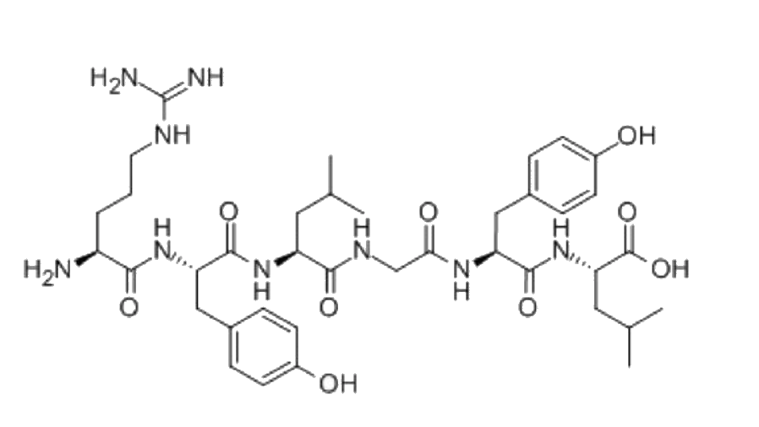
Station #4: Grandma’s Secret Ingredient
Days before Thanksgiving, you are helping your grandma prepare her special, homemade cheesecake. “You have to start by mixing milk and vinegar to make the fresh ricotta cheese,” she says.
Change in milk?
Change in vinegar?
Claim: Physical and/or Chemical?

Slide 6
Station #5: Grandpa’s Gravy
While making Thanksgiving dinner, you are asked to help with the gravy. Grandpa says, “It’s too thing?” He explains that adding cornstarch will help to thicken the gravy to make the perfect product.
Change in cornstarch?
Change in water?
Claim: Physical and/or Chemical?

Slide 7
Station #6: What a Kool Aunt
Your aunt from out of town shows up late to Thanksgiving dinner due to a delayed flight, so instead of making her famous punch, she’s decided to go simple with some classic Kool-Aid. The recipe calls for Kool-Aid powder mixed with water.
Change in Kool-Aid?
Change in water?
Claim: Physical and/or Chemical?

Slide 8
Station #7: SWEET Potato Casserole
Your cousin swears, “No Thanksgiving dinner is complete without the sweet potato casserole; and no sweet potato casserole is complete without marshmallow topping!” Curious, you watch while your cousin roasts marshmallows on top of their casserole.
Change in Marshmallow?
Claim: Physical and/or Chemical?

Slide 9
Station #8: Entertaining the Kiddos
While the adults make food and do other adult things, you have reluctantly been put in charge of entertaining your 3 younger cousins. Wanting to make this time as simple as possible, you get out the crayons and hope for the best. They won’t eat them right…
Change in Coloring sheet?
Claim: Physical and/or Chemical?

