Slide 1
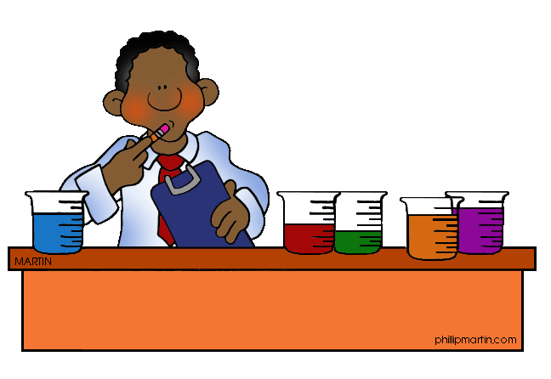
The Scientific Method
How do we do science????

Slide 2
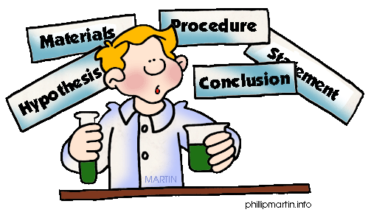
The Scientific Method
1.3
The Scientific Method
What are the steps in the scientific method?

Slide 3
The Scientific Method
Scientific method: the process by which scientists investigate a scientific problem/observation
Steps in the scientific method include:
Making Observations (leads to a problem/question to investigate)
Developing a Hypothesis
Developing a Controlled Experiment (includes identifying variables, constants, and control group and writing a procedure)
Collecting and Analyzing Data
Forming a Conclusion
Communication

Slide 4
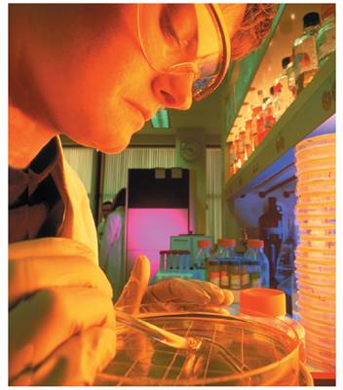
The Scientific Method: Making Observations
1.3
An observation: when you use your senses to obtain information.
ex. Suppose you have some plants that are beginning to die. An observation can lead to a question: What is wrong with the plants?
There are 2 types of observations:
Quantitative: involve numbers and measurements
Qualitative: use your 5 senses
Notes:
Observation is an essential step in the scientific method.

Slide 5
The Scientific Method: Making Observations
1.3
Observations vs Inferences
Inference: Making a mental judgment based on observations; cannot be directly observed; not a fact
Can only be used in the conclusion of a lab
Observations
That plant is extremely wilted.
The car stopped running
The Sox are leading their division
Inferences
That plant is extremely wilted due to a lack of water.
The car stopped running because it was out of gas.
The Sox are leading their division because they are playing well right now.
Notes:
Observation is an essential step in the scientific method.

Slide 6
The Scientific Method: Developing a Hypothesis
1.3
A hypothesis: an educated guess (inference) that tries to explain a scientific observation, question or problem and must be testable; a testable inference
Ex. You guess that the plants needs more water. You can test your hypothesis by giving the plants different amounts of water. If the plants becomes healthier with more water, you can be fairly certain that your hypothesis is supported.
Hypotheses are written as an “if…then…” statement
Ex If I give the plants more water then they will be healthier.

Slide 7
The Scientific Method: Develop a Controlled Experiment
1.3
An experiment/investigation: a procedure that is used to test a hypothesis
When you design experiments, you deal with variables: factors that change in an experiment
2 types of variables:
Independent variable (manipulated variable): the factor that the experimenter changes during the experiment; If you are the experimenter you say it’s the variable “I” change
The independent variable will determine your experimental groups.
Dependent variable (responding variable): factor that changes in response to the independent variable; experimenter makes observations of this variable
A controlled experiment: an experiment that contains only one independent variable.

Slide 8
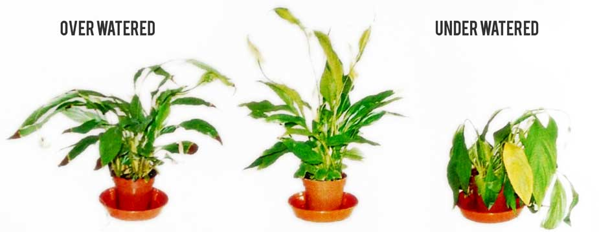
The Scientific Method: Develop a Controlled Experiment
1.3
In our Plant example:
Independent variable: amount of water given to each plant (mL)
Dependent variable: the health of the plants

Slide 9
The Scientific Method: Develop a Controlled Experiment
1.3
The independent variable determines your experimental and control groups.
Experimental group(s): Groups in which the independent variable is changed
Control group: The “normal” or “no treatment” group; used to compare to experimental groups
Sometimes the control group is experimenter selected.
Besides the independent variable, everything else stays the same. These are called constants.
Constants: factors that remain the same in an experiment.

Slide 10
Making Observations
John watches his grandmother bake bread. He ask his grandmother what makes the bread rise.
She explains that yeast releases a gas as it feeds on sugar.

Slide 11
Initial Observation →Problem/Question
John wonders if the amount of sugar used in the recipe will affect the size of the bread loaf?

Slide 12
Developing a Hypothesis
John researches the areas of baking and fermentation and tries to come up with a way to test his question.
He keeps all of his information on this topic in a journal.

Slide 13
Developing a Hypothesis
After talking with his teacher and conducting further research, he comes up with a hypothesis.
“If more sugar is added, then the bread will rise higher, because the yeast will have more sugar to use”

Slide 14
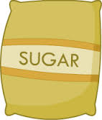
Developing a Controlled Experiment: Identify the Independent Variable
The independent, or manipulated variable, is a factor that’s intentionally varied by the experimenter.
Independent variable: The amount of sugar
Experimental groups: John is going to use 25g., 50g., 100g., 250g., 500g. of sugar in his experiment.

Slide 15
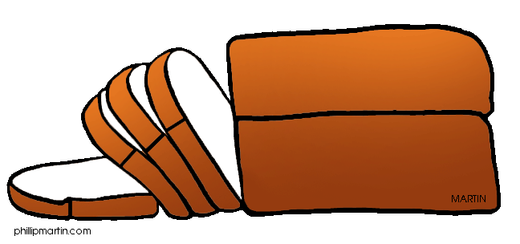
Developing a Controlled Experiment: Identify the Dependent Variables
The dependent, or responding variable, is the factor that may change as a result of changes made in the independent variable.
Dependent Variable: the size of the loaf of bread

Slide 16
Developing a Controlled Experiment: Identify the Control Group
Remember: In a scientific experiment, the control is the group that serves as the standard of comparison.
The control group may be “no treatment” or an “experimenter selected” group.

Slide 17
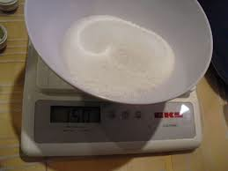
Developing a Controlled Experiment: Identify the Control Group
Because his grandmother always used 50g. of sugar in her recipe, John is going to use that amount in his control group.

Slide 18
Developing a Controlled Experiment: Identify the Constants
John’s teacher reminds him to keep all other factors the same so that any observed changes in the bread can be attributed to the variation in the amount of sugar.
What would be some constants for John’s experiment?

Slide 19
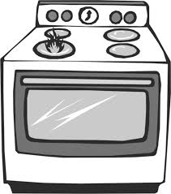
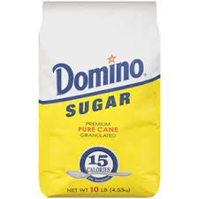
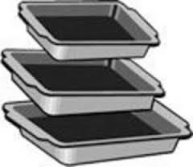
Developing a Controlled Experiment: Identify the Constants
They might include:
Other ingredients to the bread recipe
Oven used
Rise time
Brand of ingredients
Cooking time
Type of pan used
Air temperature
Humidity where the bread was rising
Oven temperature
Age of the yeast…etc.

Slide 20
The Scientific Method: Developing a Controlled Experiment continued…
1.3
Once the variables, constants, and control group are identified, a procedure with materials list is developed
Procedure: a somewhat detailed, step-by-step description of how you will conduct your experiment; includes the materials needed
Checklist for the procedure
Every step of the experiment is included
Each step is short
If someone followed your procedure they would get the same results
The materials list must be VERY complete.
How much of each material will be used in the experiment (25-mL of water or 250-mL of water)
The size of all equipment (ex 25-mL beaker or 250-mL beaker)

Slide 21
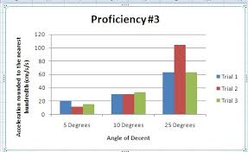
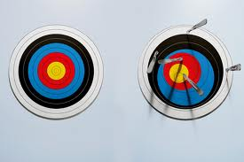
Developing a Controlled Experiment: Procedure Trials
Experiments require many trials to improve accuracy of the data collected.
Trials: replicate groups that are exposed to the same conditions in an experiment.

Slide 22
Doing the Experiment: Procedure/Materials
John’s teacher helps him come up with a procedure and list of needed materials.
The materials list must be VERY complete.
How much of each material will be used in the experiment (25-mL of water or 250-mL of water)
The size of all equipment (ex 25-mL beaker or 250-mL beaker)
Every step of the experiment is included
Each step is short

Slide 23
Doing the Experiment: Procedure
John writes out his procedure for his experiment along with a materials list in his journal. He has both of these checked by his teacher where she checks for any safety concerns.

Slide 24
Trials
John is going to test each sugar variable 3 times.
Then she discusses with John how to collect the data.

Slide 25
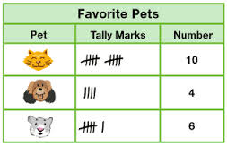
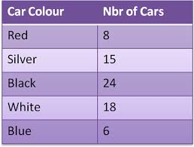
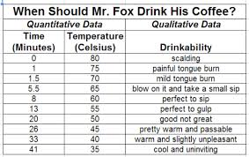
Scientific Method: Collect & Analyze Data
As you are performing the experiment you will need to make observations (both quantitative and quantitative) and record it as data in a data table.
Data: recorded observations made during an experiment
Data table: a visual display of data using rows and columns

Slide 26
Scientific Method: Collect & Analyze Data
When quantitative data is collected, a graph can be used.
graph: a visual display of quantitative data
Helps to better visualize data
A well designed graph is like a picture worth a thousand words
Easier to see trends and patterns

Slide 27
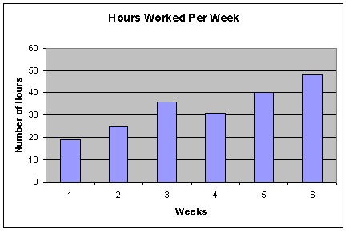
Scientific Method: Collect & Analyze Data
The 4 Major Parts of a Graph
Title
Dependent
Variable
Axis Scales
Independent Variable

Slide 28
Graphing Essentials
Scientific Method: Collect & Analyze Data
X- axis = horizontal axis, displays independent variable
Independent variable- variable that is changed or manipulated; experimenter controls directly
Y-axis = vertical axis, displays dependent variable
Dependent variable- responding variable; changes as independent variable changes

Slide 29
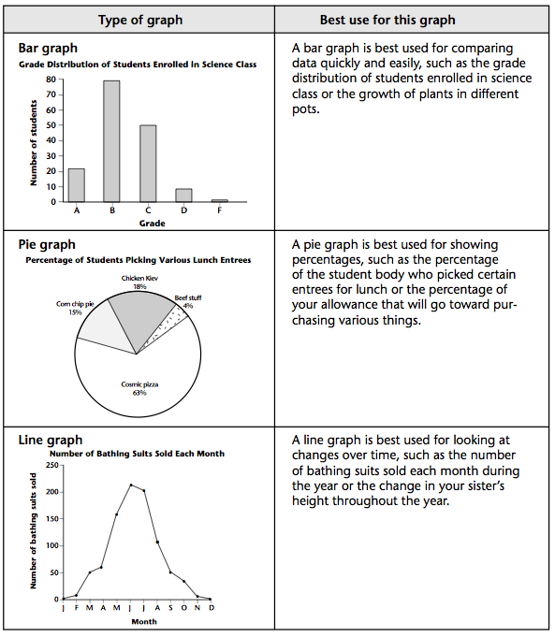
Types of Graphs
Scientific Method: Collect & Analyze Data
Bar graph
Line graph
Pie chart

Slide 30
Bar and Line Graph Checklist
Scientific Method: Collect & Analyze Data
Title
X-axis and y-axis scales
Labels on each axis (variables)
Units on each axis if needed
Neat (used a ruler)

Slide 31
Collect and Analyze Results
John comes up with a table he can use to record his data.
John gets all his materials together and carries out his experiment.

Slide 32
Size of Baked Bread (LxWxH) cm³
Size of Bread Loaf (cm³)
Trials
Amt. of Sugar (g.) | 1 | 2 | 3 | Average Size (cm³)
25 | 768 | 744 | 761 | 758
50 | 1296 | 1188 | 1296 | 1260
100 | 1188 | 1080 | 1080 | 1116
250 | 672 | 576 | 588 | 612
500 | 432 | 504 | 360 | 432
Control group

Slide 33
Collect and Analyze Results
John examines his data and notices that his control worked the best in this experiment, but not significantly better than 100g. of sugar.

Slide 34
- At the end of your experiment, you must communicate your findings with a conclusion Conclusion Checklist
Scientific Method: Forming and Communicating Conclusion
What was the question/problem you were investigating?
What was your hypothesis?
Is your hypothesis supported or unsupported by your data?
What is the explanation for what happened in the experiment?
What improvements would you make next time?

Slide 35
Conclusion
John’s hypothesis is unsupported so John rejects his hypothesis, but decides to re-test using sugar amounts between 50g. and 100g.

Slide 36
Conclusion
John finds that 70g. of sugar produces the largest loaf.

Slide 37
Communicate the Results
John tells his grandmother about his findings and prepares to present his project in Science class.

