Slide 1
Classification of Matter

Slide 2
Matter
Reminder:
Matter: Anything that has mass and takes up space (has volume)
Matter is also made up of small particles called atoms

Slide 3
Atomic Structure
Atoms are the smallest possible unit into which matter can be divided, while still maintaining its properties.
2 areas in the atom:
    Nucleus: middle of the atom; most of the mass
    Electron Cloud: surrounds the nucleus; mostly empty space
(Atom is mostly empty space)
-
+
-
+
+
-
+
-

Slide 4
Atomic Structure
3 subatomic particles:
  protons
  neutrons
  electrons
-
+
+
-
+
+
-
+
-
-

Slide 5
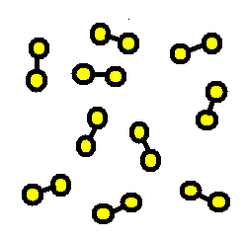
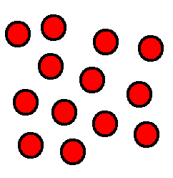
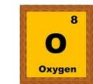
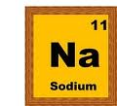
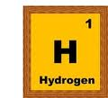
Elements
Made up of one type of atom
Found on the Periodic Table
Examples: aluminum, helium, hydrogen, potassium, etc.

Slide 6
Periodic Table
The periodic table organizes the different types of atoms (elements) in a particular way.
  You can predict the physical and chemical properties of the elements.

Slide 7
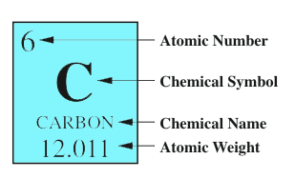
What’s in a square?
Different periodic tables can include various bits of information, but usually:
  atomic number
  chemical symbol
  chemical name
  atomic mass (weight)

Slide 8
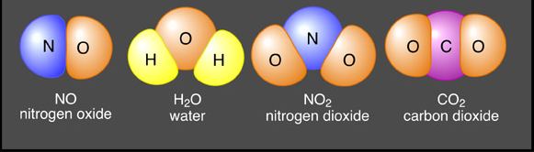
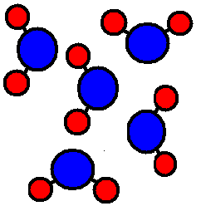
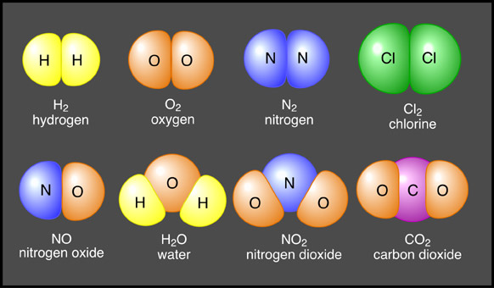
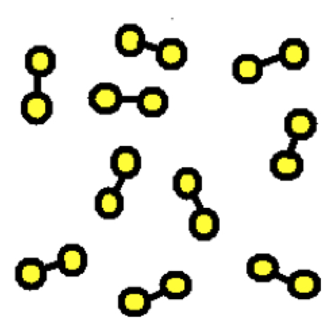
Compounds/Molecules
Compounds: Molecules with two or more different elements chemically bonded together
  Have chemical formulas (ex. NaCl, H₂O, CH₄)
Molecules: Two or more elements chemically bonded together
  All compounds are molecules, but not all molecules are compounds
  Have chemical formulas (ex. H₂, O₂, N₂)

Slide 9
Molecule, Compound, or Both?
N₂
_{Nitrogen}
NO₂
_{Nitrogen Dioxide}
Cl₂
_{Chlorine}
CO₂
_{Carbon Dioxide}
O₂
_{Oxygen}
CH₄
_{Methane}
H₂
_{Hydrogen}
NO
_{Nitric Oxide}
H₂O
_{Water}

Slide 10
Practicing Molecular Models
Molecule of Hydrogen Gas (H₂) | Molecule of Table Salt (NaCl) | Molecule of Water (H₂O)
Na
Cl
O
H
H
H
H
Notes:
Return to class notes

Slide 11
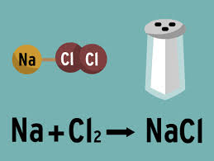
How Compounds/Molecules are Made or Broken
Chemical Reaction: Process in which matter chemically changes, causing new substances to form
ex. Na (metal highly reactive with water) + Cl₂ (poisonous gas) → NaCL: something delicious

Slide 12
Why does matter chemically change?
Atomic bonds are made or broken during a chemical reaction
Notes:
Linked to slide #11 for review of bonding; can briefly discuss Collision Theory

Slide 13
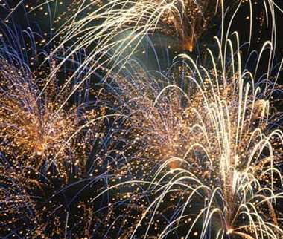
Evidence of Chemical Reactions
Fizzing
  Formation of gas
Aroma
Replacement
Temperature
new Substance(s)
Light
Sound
Color Change
Fireworks!

Slide 14


F.A.R.T.S?!?!?!?!
When You Eat a Slice of Pizza
Substances at Beginning of Digestion | Substances at End of Digestion
Bread Cheese Toppings of Choice Tomato Sauce | Fart: 59% Nitrogen 21% Hydrogen 9% Carbon dioxide 7% Methane 4% Oxygen 1% Hydrogen sulfide gas

Slide 15
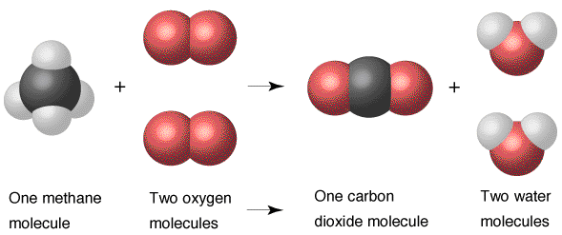
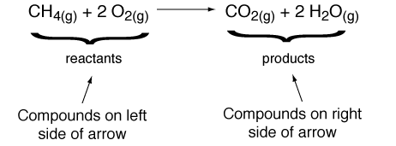
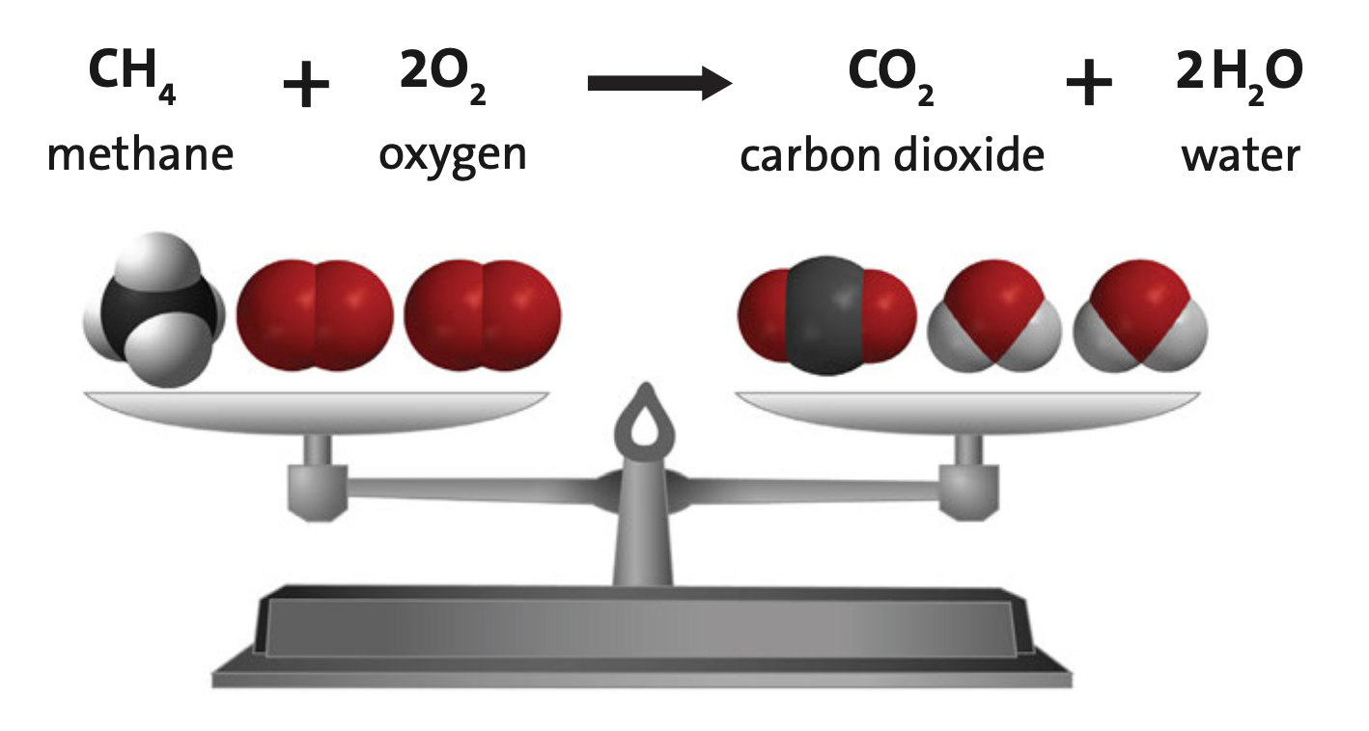
Chemical Equations
Chemical Equations: used to show chemical reactions and how much of each reactant and product are needed
  Reactants: substance(s) at the beginning of the reaction (left side of arrow)
  Products: substance(s) at the end of the reaction (right side of arrow)
Law of Conservation of Matter:
  The mass of the reactants is always equal to the mass of the products in a chemical reaction
  Same number of atoms on both sides of the equation

Slide 16
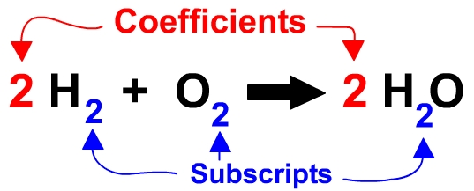
Chemical Equations: Coefficients and Subscripts
  Coefficients: numbers in front of the reactants and products that tell how many are needed for the reaction
  4 Al _{(s)} + 3 O_{2 (g)} ---> 2 Al₂O_{3 (s)}
  Subscripts: numbers written below and after the elements that tell how many atoms there are

Slide 17
Symbols Used in Chemical Equations
Symbol | Purpose
2H₂O | Example of a chemical formula; identifies atoms or molecules in the reaction; and the amount needed for reaction to occur
+ | Separates more than one reactant or product; say plus
→ | Separates reactants from products; indicates direction of reaction; say yields (makes)
(s) | Identifies a solid state
(aq) | Identifies a substance that is dissolved in water; aqueous solution
(l) | Identifies liquid state
(g) | Identifies gas state

Slide 18
Components of a Chemical Equation
Chemical
Formulas
Chemical
Formula
2H₂ + O₂
→
2H₂O
Coefficient
Subscript
Subscripts
Coefficient
(Yield)
(Reactants)
(Products)
Sometimes you will see a “yields” sign that looks like this.
What do you think it means?

Slide 19

Modeling Chemical Reactions
Chemical Equations: used to show chemical reactions, and to prove that new substances form during a reaction
  Reactants: substance(s) at the beginning of the reaction; left side of arrow
  Products: substance(s) at the end of the reaction; right side of arrow
Carving a Pumpkin
Reactants Products
CaC₂(s) + 2H₂O(l) → Ca(OH)₂(s) + C₂H₂(g)

Slide 20
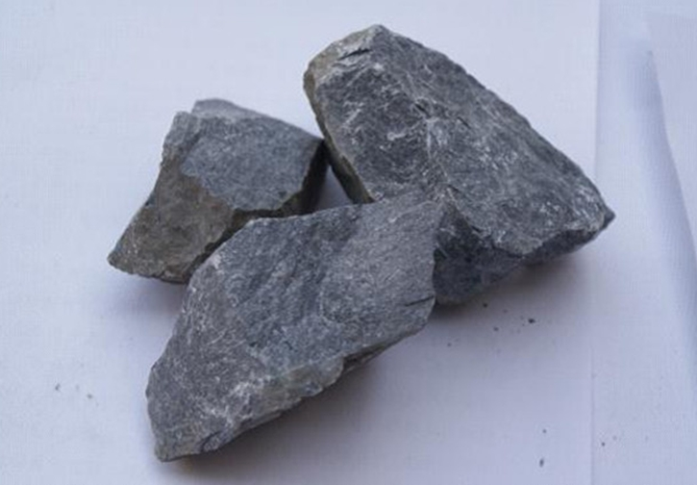
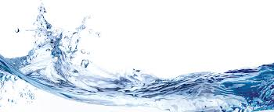
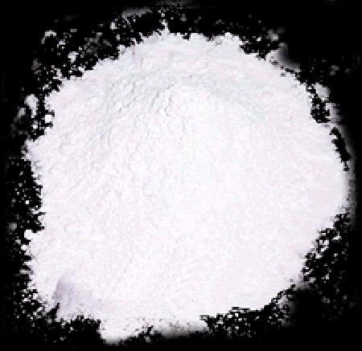
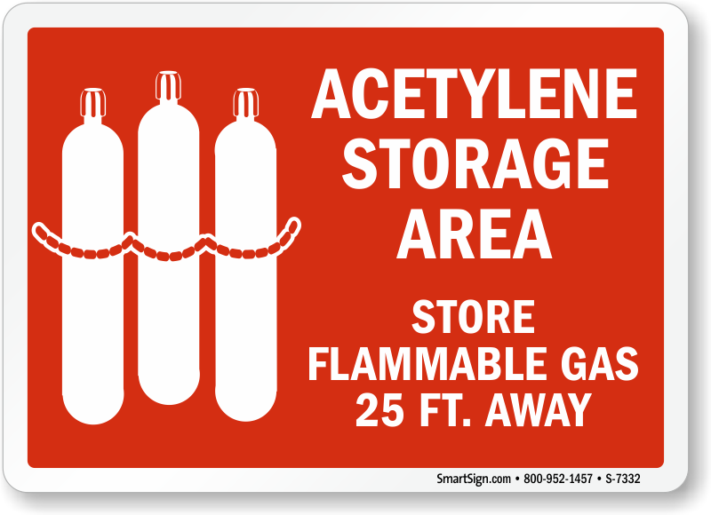
Carving a Pumpkin
Carving a Pumpkin
 | Reactants |  | Products
Name | Calcium Carbide | Water | Calcium Hydroxide | Acetylene Gas
Properties | Powder Solid Gray Highly Reactive | Colorless Odorless Liquid | Powdered Solid White | Flammable Gas Colorless Odorless
CaC₂(s) + 2H₂O(l) → Ca(OH)₂(s) + C₂H₂(g)
+
→
+
+
→
+

Slide 21
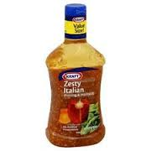
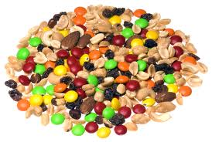
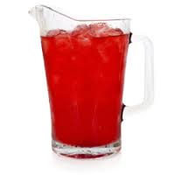
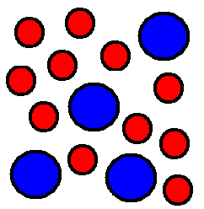
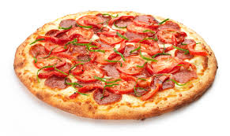
Mixtures
Made up of a combination of compounds and/or elements that can be taken apart physically (not bonded together)
  Ex. Salt water, kool-aid, salad dressing, pizza; trail mix, etc.

Slide 22
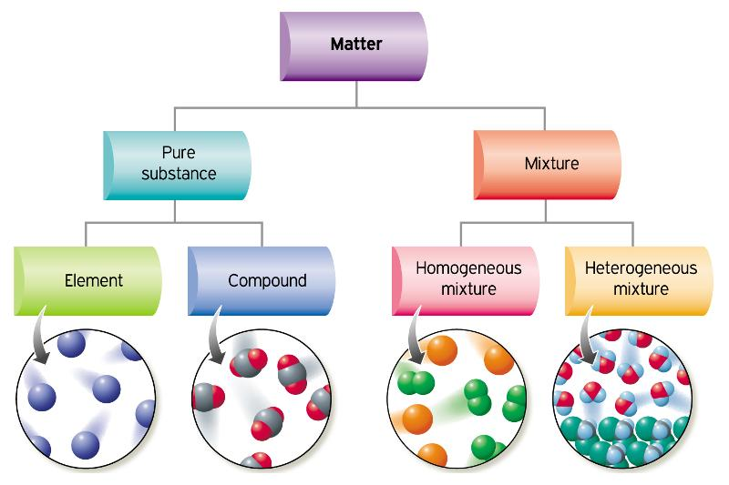
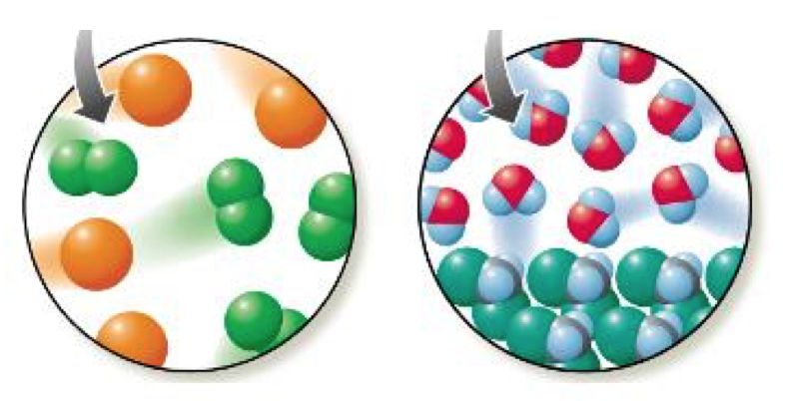

Slide 23
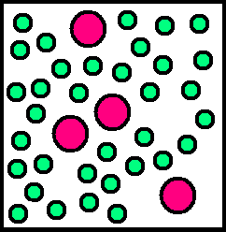
Element, Compound, Molecule or Mixture?

Slide 24
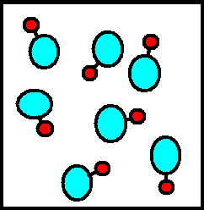
Element, Compound, Molecule or Mixture?

Slide 25
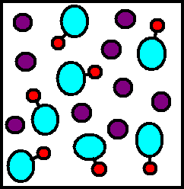
Element, Compound, Molecule or Mixture?

Slide 26
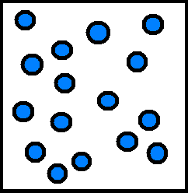
Element, Compound, Molecule or Mixture?

Slide 27
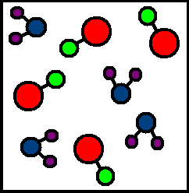
Element, Compound, Molecule or Mixture?

Slide 28
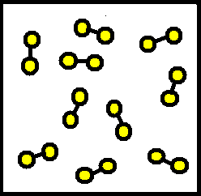
Element, Compound, Molecule or Mixture?

