Slide 1
Bath Bombs
Investigation Question: What happens when a bath bombs is added to water (and what causes it to happen)?
Lesson 1

Slide 2
Slide A
Exploring Some Interesting Phenomena
Turn and Talk
Have you heard of bath bombs before? What is your experience with bath bombs?
What do you predict will happen when the bath bomb I got from the store is placed in a bowl of water?
Notes:
Start of Day 1
Introduce the context of how you got some “store bought” bath bombs.
If someone ordered bath bombs for you and you test one before class, then you can say something like this to introduce the bath bombs you are about to show them, “A colleague got me something recently from the store called a bath bomb. I tried it at home (or school) and found it did something pretty interesting. Have you heard of these? What do you know about them? What are your experiences with bath bombs?”
Show slide A. Give a couple of minutes to have students turn and talk with a partner about the questions on the slide.
Help students plan for the first investigation. Bring the class back together. Hold up a sample bathbomb and introduce what we plan to do next with it, saying, “The directions on the package suggest that they are fun to add to water. Let’s get ready to take some observations of the bath bombs I got from the store before and after we add one to some water.“

Slide 3
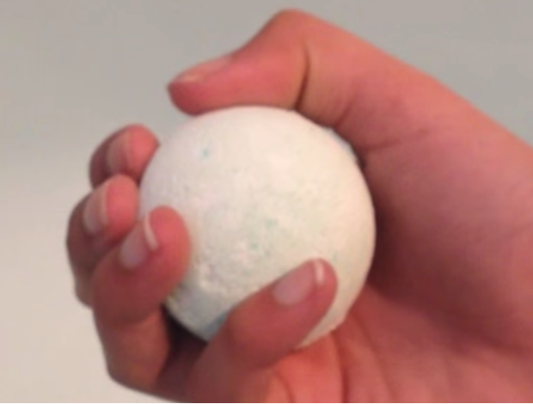
Slide B
Set Up a Notice and Wonder Chart
Use this space to record what you notice and wonder about the store-bought bath bomb, before and after we add it to water.
Store-bought
Bath Bomb
Notice
Wonder
Notes:
Prepare science notebooks to record noticings and wonderings. Have students title a new page in their notebooks, and make a T-chart below the title to record their noticings and wonderings for what they notice about the bath bomb.
Then have students bring their science notebooks and reconvene having them sitting in a Scientists Circle on the floor, around a bowl of water in the middle of it that everyone can see. The students should be about 8-10 feet from the bowl of water.
Hold up a store bought bath bomb and tell students that they each should take about 20 seconds to examine the bath bomb as it is passed around to them and then record what they notice and wonder before passing it to the person on their right.
Pass some bath bombs around the circle. Hand out six store bought bath bombs starting them at different parts of the circle, and have students pass them around in the same direction (e.g. to their right). Tell students to take no more than 20 seconds each before passing it on, and then record anything they notice and wonder about it.
When one of the bath bombs gets back to you say that you are going to collect all the bathbombs in a minute and then will put one of the in the bowl of water for everyone to watch it together, so that each person can add to their noticing and wonderings. Take a show of hands of who all has examined the bath bombs first hand to confirm that everyone has, before collecting them.
Say, “Think for a minute about whether there is any additional data you want us to collect before I put the bath bomb in the water”
Ask for any additional suggestions. Have a thermometer available or scale at table some distance away from the circle, in case students ask for it. Only use these devices if students suggest the idea of using them now, but don’t suggest either of these devices yet if they don’t.
Put one bath bomb in the bowl of water. Save the rest of the bath bombs to pass around for your next classes and future investigations. Remind students to record what they notice and wonder over the next few minutes.
Record some noticings that students share out. After about three minutes, have students report out what they noticed. Show slide C
[9 min] Recording Noticing and Wonderings for our first investigation
Then have students bring their science notebooks and reconvene sitting in a Scientists Circle, but on the floor, around a bowl of water in the middle of it.
Hold up a store bought bath bomb and say “ What kind of data might we want to collect before putting the bath bomb in the water?”
Sample student responses:
We should record the color
The odor
How it feels
How it looks
How heavy it is
How big it is
Students may say either of the following: The temperature of the bath bomb and the water or the weight of the bath bomb before and after adding to the water
Then say, “Okay, what kind of data do we want to collect immediately after adding it to the water and over the next few minutes after that?”
Sample student responses:
What set see happen right when the bath bomb touches the water
The temperature of the water at first and after the bath bomb is done
How it smells
The color of the water
How much the bath bomb weighs after it is done
Can we see the bath bomb still after it is added to the water?
As a whole group, pass around three to four of store bought bath bombs starting at different parts of the circle, and have students pass them around in the same direction. Tell students to take about 20 seconds before passing it to their right, and then record what they notice and wonder it.
When one of the bath bombs gets back to you say that you are going to collect them all in a minute and put one of them in the bowl of water for everyone to watch it together, so that each person can add to their noticing and wonderings.

Slide 4
Slide C
Noticing and Wondering
Small Group Discussion
Turn to your table group: What are some things we noticed about the store-bought bath bomb, before and after we added it to water?
Make a list of any similar questions you hear during your table group discussion.
Notes:
List their noticings on a poster titled, “What we noticed happened to the store bought bath bomb”.
Example responses:
A.The solid we start with breaks apart into smaller pieces when it is added to water
B. After a while the solid we started is no longer visible (or there is less of it visible)
C. Fizzing/Bubbles appear around or on the bath bomb when it is added to water.
D. There is a smell or scent after bubble appear.
E. A film appears on the water.
F. The water becomes cloudy.
When the idea of fizzing or bubbles appearing is raised, foreground the idea that the bubbles aren’t empty and that they must be filled with some kind of gas. For example you could say, “So we put the solid bathbomb in water which is a liquid. But then gas bubbles appeared.”
Add the addendum phrase “gas bubbles” to the list of noticings if students are in agreement with that idea. If students aren’t in agreement that it is a gas inside the bubbles, then still add the phrase but put a question mark near that phrase and underline it and suggest maybe that is something they can get evidence to argue either way when we test some more bath bombs in a little bit so we can decide whether to accept or reject the claim regarding gas in the bubbles.
You will hear students raise different kinds of questions too at this point. Questions you might hear raised during this sharing out might include things like this:
What is the bath bomb made of?
What happened to it?
What is causing the (gas) bubbles?
What is the odor from?
What is the film from?
Why is the water is cloudy?
Did the bath bomb dissolved in it? Did it melt?\
Don’t record student questions yet. Acknowledge the questions that are raised as being valuable and worth keeping track of (for the students). For example, when you hear a few questions shared you could say something like, “I am hearing a bunch of really cool question(s) coming out right now. I am glad you sharing these. I hope you keep track of those too, as you might decide you want to add some of those to our driving question board in a bit. Don’t forget to add more questions to your notebook as they come up for you
Planning Our Second Investigation
Introduce the homemade bath bomb context by saying something like, “I have just a few store bought bath bombs. I realized would be kind of pricey to buy enough samples from the store for every group to have their own to use and enough for us to do additional experiments with, so I looked up how to make homemade ones. I found multiple different recipes with different ingredients, and made a large batch of each of those for you to work with. I broke the samples from a large batch form each different recipes for you all to investigate in a group of three. Lets head back to our seats so you can start to make a plan about how you want to work with the materials we have available and what data you will want to collect“
Have students return to their regular seats.
Introduce the idea of planning what kind of data we want to collect. Show slide D describing the materials they will have to work with.

Slide 5
Slide D
Noticing and Wondering
Whole Group Discussion
What are some things we noticed about the store-bought bath bomb, before and after we added it to water?
Notes:
List their noticings on a poster titled, “What we noticed happened to the store bought bath bomb”.
Example responses:
A.The solid we start with breaks apart into smaller pieces when it is added to water
B. After a while the solid we started is no longer visible (or there is less of it visible)
C. Fizzing/Bubbles appear around or on the bath bomb when it is added to water.
D. There is a smell or scent after bubble appear.
E. A film appears on the water.
F. The water becomes cloudy.
When the idea of fizzing or bubbles appearing is raised, foreground the idea that the bubbles aren’t empty and that they must be filled with some kind of gas. For example you could say, “So we put the solid bathbomb in water which is a liquid. But then gas bubbles appeared.”
Add the addendum phrase “gas bubbles” to the list of noticings if students are in agreement with that idea. If students aren’t in agreement that it is a gas inside the bubbles, then still add the phrase but put a question mark near that phrase and underline it and suggest maybe that is something they can get evidence to argue either way when we test some more bath bombs in a little bit so we can decide whether to accept or reject the claim regarding gas in the bubbles.
You will hear students raise different kinds of questions too at this point. Questions you might hear raised during this sharing out might include things like this:
What is the bath bomb made of?
What happened to it?
What is causing the (gas) bubbles?
What is the odor from?
What is the film from?
Why is the water is cloudy?
Did the bath bomb dissolved in it? Did it melt?\
Don’t record student questions yet. Acknowledge the questions that are raised as being valuable and worth keeping track of (for the students). For example, when you hear a few questions shared you could say something like, “I am hearing a bunch of really cool question(s) coming out right now. I am glad you sharing these. I hope you keep track of those too, as you might decide you want to add some of those to our driving question board in a bit. Don’t forget to add more questions to your notebook as they come up for you
Planning Our Second Investigation
Introduce the homemade bath bomb context by saying something like, “I have just a few store bought bath bombs. I realized would be kind of pricey to buy enough samples from the store for every group to have their own to use and enough for us to do additional experiments with, so I looked up how to make homemade ones. I found multiple different recipes with different ingredients, and made a large batch of each of those for you to work with. I broke the samples from a large batch form each different recipes for you all to investigate in a group of three. Lets head back to our seats so you can start to make a plan about how you want to work with the materials we have available and what data you will want to collect“
Have students return to their regular seats.
Introduce the idea of planning what kind of data we want to collect. Show slide D describing the materials they will have to work with.

Slide 6
Slide E
Planning an Investigation
The supplies listed below will be available to your team. Additional measurement devices are available upon request.
Samples of 4 different homemade bath bombs made from 4 different recipes (A, B, C, and D), Paper plates, clear plastic sealable baggies, toothpicks, a pipette, clear plastic cups, water from the sink, and paper towels for cleaning up, thermometer, and electronic balance
Identify the following in your student notebook: independent variable, dependent variable, and constants
Discuss the following with your lab group:
What types of data would you want to try to collect about the homemade bath bombs to help you figure out what happens when bath bombs are added to water?
Notes:
Introduce the idea of planning what kind of data we want to collect. Frame the need to think about possible data collection by saying, “If we are trying to figure out what causes bath bombs to do what they do, then what type of observations would you want to try to collect from each of these samples? Talk with your small group for three minutes“
Some groups may ask if a scale or thermometer is available for them to use. If they do offer that group use of those tools too. But if groups don’t suggest these ideas, don’t suggest them.
[10 min] Planning Our Second Investigation
Introduce the homemade bath bomb context, Have students return to their regular seats and project this slide.
Say, “I have just a few store bought bath bombs. I realized would be kind of pricey to buy enough samples from the store for every group to have their own to use and enough for us to do additional experiments with, so I looked up how to make homemade ones. I found multiple different recipes with different ingredients, and made a large batch of each of those for you to work with. I broke the samples from a large batch form each different recipes for you all to investigate with a partner. “
Introduce the idea of planning what kind of data we want to collect.
Suggest that, “If we are trying to figure out what causes bath bombs to do what they do, then what type of observations would you want to try to collect from each of these samples? Talk with your elbow partner to 2 min. Then be ready to share. “
Give 2 min turn and talk
Then have students share out their ideas. Take five minutes to do this recording their ideas on poster paper ,. “Observations of the homemade bath bombs we want to try to collect “
The purpose of this discussion is to have students work together to agree on what data needs to be collected. Then they will use these ideas to create a data table in the next step of the lesson.
Suggested prompts:
What kinds of observations did we take of he store bought bath bomb that we want to take of these ones too?
Do we want to collect additional data or observations of the home made bath bombs before adding them water?
What about right after adding to water?
What kinds of observations will help us determine how these bath bombs compare to each other?
Student sample responses:
We should record the color, the odor, how it feels
We should see how much is left
We should look for what we can see is in the wonder
We should notice where the bubbles are coming from.
The following MAY come up. But if they don’t, don’t suggest these ideas. If they do come up, then say “Interesting. What are you thinking that might show you?”. Here are possible other ideas that you might hear:
We should weigh it before and after
We should take the temperature of the water and the solid before and after
We should mix it all in a bag.
We should try to break part of it up and see what is on the inside.

Slide 8
Slide F
Set Up the Planning for Our Second Investigation
In the data table titled “Homemade Bath Bomb Observations” in your notebook, work with your group to record your observations from each of the samples.
Store-bought
Bath Bomb
Homemade Bath Bomb Observations
Notice
Wonder
Make sure each person gets an opportunity to work with at least one bath bomb sample and do at least one test with it.
Notes:
Show slide E. Instruct students to work with their small group to make a data collection table for what they hope to record from their observations on a new page of the notebook, following the directions on the slide. Remind students that this is also a time where they can make sure that they are being equitable in the co-design of their investigation, by ensuring that as they structure this data table they are also checking in to make sure each person in their group will get an opportunity to work with at least one bath bomb and do at least one of tests that person is interested in trying.
After groups complete their data table preparation have them come up and get supplies to test.
Carrying Out Our Second Investigation
Give the remaining time for students to conduct their investigations. Listen in on student discussions during this time to hear the types of noticings they raise and the way they coordinate group work tasks. Make sure to leave 15 minutes after students have cleaned up to come back to their seats for a whole group discussion and the individual modeling task at the end of the period on the first day.
[15 min] Planning and Carrying Out Our Second Investigation
Have students prepare notebooks for the investigation. Present this slide. Have students set-up a data table to record their observation in their notebooks, as shown on the slide.
Conduct the investigation
Students should collect the materials they need and make observations. As students work through the investigation, visit each lab group and encourage them to make good detailed observations.
In the last three minutes, remind students, “Once you are finished with your observations and you have cleaned up, leave your lab area and talk as a lab group about what noticing and wondering. Be ready to share with the whole class.”

Slide 10
Slide G
Noticing and Wondering
Whole Group Discussion
Share things you noticed about the homemade bath bombs, what they did, and how they compared to the store-bought ones.
Notes:
Report out Patterns in Whole Group Discussion
Project slide F. Take five minutes or less to have student volunteers share out some some things they noticed about these homemade bath bombs and what they did and how they compared to the store bought ones. Start with sharing out what things were the same as the store bought ones, in case time is limited and you need to skip sharing out what was different.
Suggested prompt
What things were the same as the store bought ones?
What things were different between them or between them and the the store bought ones?
Sample student response
They all were solids to start with
They all broke apart in water
Gas bubbles appeared in both.
They had different smells
They had different colors
Some broke apart easier than others
Some felt smoother or oilier
Some left a film in the water and some did not.
Foreground two aspects of the phenomena that were common across all the experiences that we should try to explain - the solid no longer being there after it was in the water and the gas bubbles appearing around it for a bit after it was added to the water.
Pass out a copy of student handout to each student. If you plan to collect the handout before the end of the period, then also pass out a blank piece of notebook paper with it. If not, then project slide G.
Read through the directions on the handout with students. Emphasize that they should include a zoomed in view to show any changes they think might be happening to the matter in the system at a scale smaller than you can see that could help explain these changes
[9 min] Recording Noticing and Wonderings for our first investigation
Then have students bring their science notebooks and reconvene sitting in a Scientists Circle, but on the floor, around a bowl of water in the middle of it.
Hold up a store bought bath bomb and say “ What kind of data might we want to collect before putting the bath bomb in the water?”
Sample student responses:
We should record the color
The odor
How it feels
How it looks
How heavy it is
How big it is
Students may say either of the following: The temperature of the bath bomb and the water or the weight of the bath bomb before and after adding to the water
Then say, “Okay, what kind of data do we want to collect immediately after adding it to the water and over the next few minutes after that?”
Sample student responses:
What set see happen right when the bath bomb touches the water
The temperature of the water at first and after the bath bomb is done
How it smells
The color of the water
How much the bath bomb weighs after it is done
Can we see the bath bomb still after it is added to the water?
As a whole group, pass around three to four of store bought bath bombs starting at different parts of the circle, and have students pass them around in the same direction. Tell students to take about 20 seconds before passing it to their right, and then record what they notice and wonder it.
When one of the bath bombs gets back to you say that you are going to collect them all in a minute and put one of them in the bowl of water for everyone to watch it together, so that each person can add to their noticing and wonderings.
Have a thermometer available or scale available in case students ask for it, but don’t suggest either if they don’t.
Some things students report as observations of the bath bomb:
The solid we start with looks like it breaks apart into smaller pieces. What is it made of?
After a while the solid we started is no longer there (or there is less of it) What happened to it?
Bubbles are produced when it is added to water. What is causing these bubbles?
There is a smell or scent to it after it bubbles What is the odor from?
There is a film in the water. What is that from?
The water is cloudy? Is the bath bomb dissolved in it? Did it melt?
Students will only mentioned this if they measured temperature: It got cooler. (This suggests that it didn’t melt, because that requires temperature to go up).
Students will only mention this if they measured this data too: The mass of the bath bomb went down after it is added to water.

Slide 11
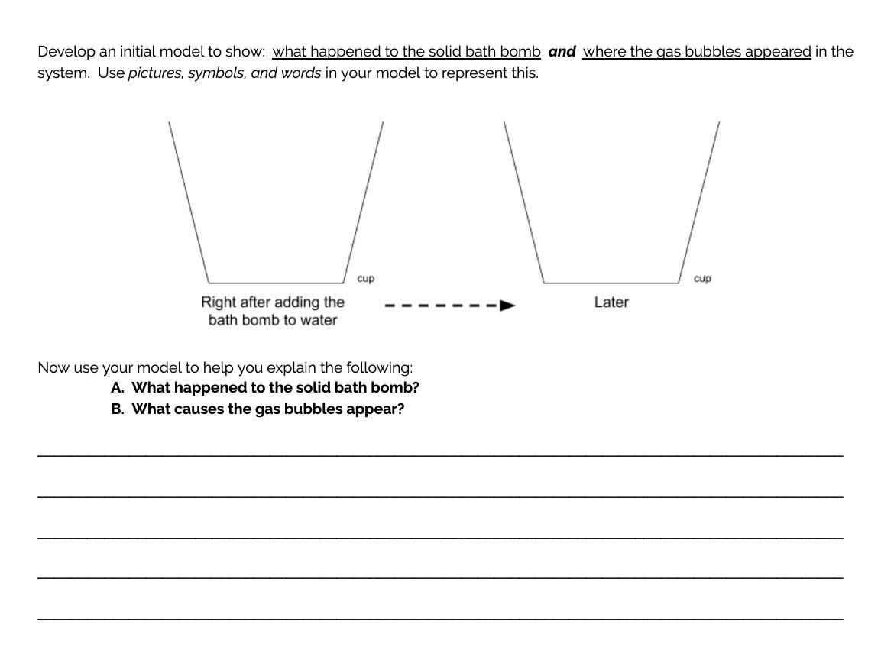
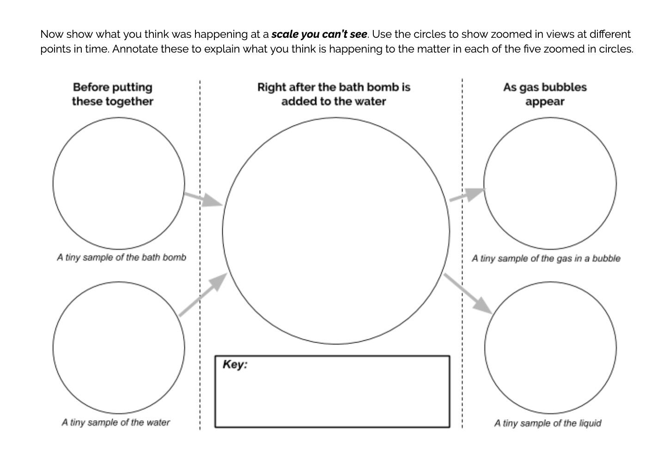
Slide H
Developing Initial Models (Pre-test)
Develop an initial model to show
what happened to the solid bath bomb and where the gas bubbles appeared in the system. Use pictures, symbols, and words in your model to represent this.
Then use your model to help you explain the following:
A. What happened to the solid bath bomb?
B. What caused the gas bubbles to appear?
Next, show what you think was happening at a scale you can’t see.
Use the circles to show zoomed-in views at different points in time.
Annotate these to explain what you think is happening to the matter in each of the five zoomed-in circles.
Notes:
Foreground two aspects of the phenomena that were common across all the experiences that we should try to explain - the solid no longer being there after it was in the water and the gas bubbles appearing around it for a bit after it was added to the water.
Pass out a copy of student handout to each student. If you plan to collect the handout before the end of the period, then also pass out a blank piece of notebook paper with it. If not, then project slide G.
Read through the directions on the handout with students. Emphasize that they should include a zoomed in view to show any changes they think might be happening to the matter in the system at a scale smaller than you can see that could help explain these changes.
Have students work for five minutes individually on this, and then ask students to start developing a written explanation of how their initial model helps explain what caused this phenomenon to happen. If you are not collecting these then you could show slide H to prompt this.
This prompt foregrounds thinking students have done numerous times in two prior OpenSciEd units in sixth grade, unit 6.2 and unit 6.3. If students ask for clarification about this prompt, remind them that they have used this sort thinking about systems and matter at a scale too small to see in two prior units in 6th grade. One unit was about trying to figure out how to keep a drink cold or warm in a container and the other was about trying to figure out why it hails, rains or snows sometimes but not others. If this is the first OpenSciEd unit for your students, you may need explain that the system is the all the stuff in the bowl of water before the solid bath bomb is added to it, right after it is added, and a few minutes later.
[6 min] Developing Initial Models.
Say, “Now you are going to create an initial model of what you saw happen when the bath bomb was placed in water. Your model should explain A. what happened to the solid bath bomb? and B. Why do gas bubbles appear?
Remind students to “Use pictures, symbols, and words in your model to help your represent and explain what you think caused the changes you observed. Include a zoomed in view to show anything you think might be happening at a scale smaller than you can see that could help explain these changes. Record any questions that come to mind as you are developing your model.”

Slide 12
Slide J
Group Models and Explanations
Small Group Discussion Protocol
Give each group member an opportunity to share their model and explanation with the group.
When it is your turn, turn your science notebook around so that your model faces others in your group.
As your group notices things about each diagram, record the following in pencil (lightly):
Place a ✓ by parts of your model or explanations that are similar to those shown on other diagrams from the group.
Place a ? by parts of your model or explanations that are different or where your group is less certain.
Records these as similarities and differences in your student notebook
Notes:
Start of Day 2
Reorient students to the initial models and explanations they developed. If you have collected students initial models and explanations, return them to students. As students enter the class, ask them to review their initial models and explanations from the previous class. Display slide I.
Prepare to compare individual models and explanations. Take a moment to have a short conversation about why we want to look at each other’s models and explanations. You will spend more time developing classroom community norms at the beginning of Day 3, but a short conversation now will make the comparison of these models and explanations productive. Ask students:
What can we learn from looking at each other’s initial ideas in their models and explanations?
What if someone has different ideas than yours?
Reinforce students ideas by saying, We want to use our time to see what other people in the class are thinking and how they thinking about what is causing the changes we saw in the bath bombs last time. We don’t need to have the same ideas because we all think differently. But we can learn from one another by closely looking at our classmates’ work. We are going to use this time to study their work closely and see if it helps our own thinking.
Compare models and explanations in small groups. Tell students that the purpose of the next activity is to compare models and explanations to note similarities and differences in the way each person is thinking about what happened to the solid bath bomb why did the gas bubble appear, paying particular attention to any changes to the matter in the system that were happening at scale that is too small to see.
Share examples and non-examples of productive comparisons (e.g., a non-productive example would be focusing on the artistry of the drawing or diagram; a productive example would be noting how other students talked about the why the bubbles appeared where they did.
Students, working in small groups of 3, will take turns sharing their work. As the group notes similarities between the diagrams, they can make a small check mark on their diagram noting that it is similar to another member in their group. If they have a different thing, or the group is confused about part of the system, they can mark those parts of the diagram with a question mark. The groups do not need to achieve consensus at this time.
[4 min] Comparing Models
Read the text on the slide and then give students the remaining time to share their models and initial explanation with a partner.

Slide 14
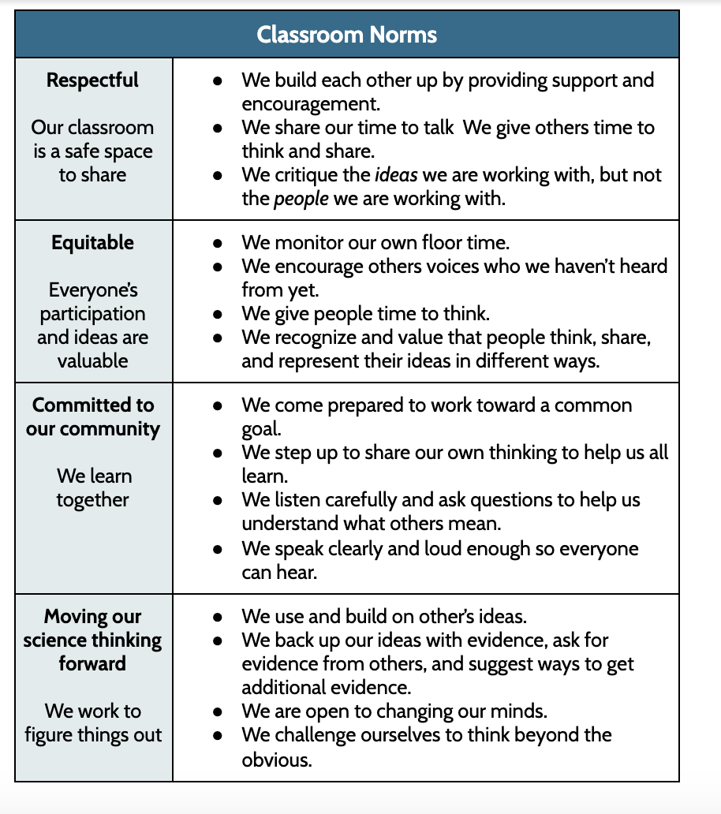
Slide K
Developing Norms for Our Discussions
Notes:
Form a Scientists Circle for the first time. Ask students to assemble their chairs in a circle and to bring their science notebooks and something to write with. They will be in this circle for most of class. Ideally they will need to be able to see the slides and have access to a whiteboard, but if that is not possible the whiteboard (or chart paper) will be more critical for the rest of the class.
You will form a Scientists Circle in many future lessons as well. Setting up the norms and logistics for forming, equitably participating in, and breaking down that space is important to do if this is your first time forming such a space. Having students sit in a circle so they can see and face one another can help build a sense of shared mission and community of learners working together. Returning to this Scientists Circle throughout the course of the unit to take stock of what the class has figured out and where they need to go next will be an important tool in helping the class take on greater agency in steering the direction of their learning. This circle will also help build a sense of pride in their work. You may want to inform students that professional scientists collaborate with one another to brainstorm, discuss, and review their work also.
Introduce the task to develop a class consensus model. Tell students that next, we’ll try to identify areas of agreement and areas of uncertainty across all of our models and explanations. The purpose of introducing the consensus task before talking about classroom norms is to get students thinking about how difficult it will be to get all members of the learning community to agree and that we should think about how we want to make sure everyone is included and everyone’s voices are heard.
Introduce science classroom norms. Tell students that before the class moves on to this next step in our work, it is time for the class to set up some norms for how the class wants to work together and learn together in science class. You may want to reiterate productive behaviors you witnessed in the first day this lesson (Lesson 1) as a way of communicating to students that they were already operating using some positive norms, but they had not yet talked about them.
When setting up community norms, students should understand how norms help everyone in the community understand what is expected of them. Two approaches to setting up norms include:
Give students a set of norms as a starting point (the default approach written in the learning plan below). Share a set of community norms with students and provide space for students to edit or add to the norms if students believe something is missing.
Co-construct norms with students (the alternate approach). Explain what norms are and why we need them for productive science talk and classroom culture. Have students co-construct norms, first sharing ideas in small groups, and then sharing out with the whole class. Compile a list of agreed-upon community norms. As the teacher, you can add norms that may be missing from the list. Make sure to explain to students how you think the norm you added is helpful, so that they are clear about why you are adding it to the list.
In selecting which approach to use, consider the following questions which can help you determine which approach is best for your situation:
Do you want students to participate is co-constructing the norms?
Do you want the same set of norms for every section of science you teach?
Do you want to work with your team teachers to establish a shared set of norms for students across all their classes?
What kinds of consequences will you enforce if students do not follow the norms?
Display slide J and pass out the handout, CA.L1.HO2. (note: edit the handout as desired).
Many students may not know what a “norm” is so tell students that norms are something that we all agree to try and work on so that we have a productive and respectful learning environment. They are similar to rules, but are intended to ensure that all students have a positive learning experience in science class, and are things that we collectively deciding as a community how learning will happen best and what we want and need to hold each other responsible for upholding.
On the slide are a set of norms that are a starting point for the class. It is important to talk through each one with students and ask them to provide an example or paraphrase the norm. The purpose of this is to develop a shared understanding of each norm. Also, provide opportunities for students to clarify a norm, ask for a modification, or develop a new norms. Allow students to write on their handout if the class decides to change something. Norms are intended to be shared by the students and teacher, so even though a set has been provided, it is just a starting point for students.

Slide 15
Slide L
Targeting a Norm to Focus On
Look at our class norms one more time. Which of the norms do you think might be particularly challenging to follow if we are out of practice? Which do we need to intentionally work at to get good at? What are some strategies that could help everyone adhere to this norm?
Choose one norm from the sheet that you personally will work on for the rest of class.
Share the norm you decided to work on with a partner, and tell them why it is important for you.
Notes:
Choose a norm to work on for the rest of class. Ask students to read through the norms one more time and nominate one norm that may be particularly challenging to follow if we are out of practice and unless we work intentionally to get good at it. Discuss a strategy or two that could help everyone adhere to it. Then, before the students end their conversation, ask students to pick one norm from the sheet that they personally will work on for the rest of class. They should share the norm with a partner and tell the partner why that norm is important for them.
It is important to use this norm building time to begin to cultivate an equitable learning community that promotes trusting and caring relationships. The norms should reinforce to students value for the diversity of the classroom community members, and equity in the sense-making work they will do together this school year. It is critical that the norms support safe and fair participation and interrupt cultural norms or stereotypes that could make science experiences feel uncomfortable to students (e.g., as being someone who is not intelligent enough to think like a scientist, who has trouble putting their thinking into writing, who cannot do the relevant math, who cannot share their thinking, etc.).

Slide 16
Slide M
Developing an Initial Consensus Model Discussion
Now let’s develop a whole-group record of what we agree on and where we have competing ideas across the initial models and explanations.
What do we all seem to agree on?
What do we disagree on?
What are some new ideas that we may want to consider?
Notes:
Let students know that the class is now ready to have a consensus-building discussion. Tell students, Remember the goal of this discussion is to figure out areas of agreement and disagreement in the initial models. Knowing where we agree and disagree will help us figure out how we might want to proceed in figuring out what is happening in the bath bomb phenomenon. We also want to use this time to practice our norms with one another.
There are two goals of this discussion:
(1) to continue to help students build the habit of sharing their ideas publicly and
(2) determine the sets of ideas that all students in the class agree with vs. the set of ideas that there is disagreement with, or we are more uncertain about.
It is again important to accept all student responses and to encourage students to share their ideas. Further, emphasize it is important to highlight areas of disagreement and help students clearly explicate their thinking in these areas. Be careful not to favorably respond to any one idea over others so as not to “give away” what might be going on in the phenomenon.
Once the class has a consensus model, step back and introduce students to the idea that they just developed a initial consensus model. Explain to students that scientists develop and use models to understand and explain phenomena and to areas of uncertainty and limitations in their current understanding. They then try to refine that model by doing additional investigations and collecting additional evidence. Over time they try to test the model to see how many other related phenomena it can explain too.
Emphasize to students that they will develop and use models for a purpose in science. Scientific models are dynamic and change as new information is learned, and models need to be “applied” to explain phenomena or design solutions to be considered useful. We develop and use models not just to be able to describe something than happened, but rather to be able to come up with a way to explain how and why it happened, or accurately predict what will happen, or engineer a way to make it happen differently. Avoid asking students to simply repeat back an element of a model or even an entire model as an inert “fact”
[15 min] Developing an initial consensus model
Present this slide and read through it. Tell students to bring their science notebooks to the Scientists Circle.
Have a couple pieces chart paper ready to develop an initial consensus model, with these questions written on it “How can we explain what we observed?
A. What happened to the solid bath bomb?
B. Why do gas bubbles appear? “
Remind students that the goal of this discussion is to figure out areas of agreement and disagreement in the initial models and explanation. Emphasize that knowing where we agree and disagree will help us identify questions we want to try to answer and ideas for investigations we want to pursue.
Before beginning the discussion, ask students to remind the group of some of the key norms for science discussions.
It is useful to develop a public record of areas of agreement and disagreement so that students may refer to their shared ideas. It also useful to use the model to make a record of the parts or pathways of the system that we aren’t in agreement on or that we might have questions about.
First try to establish agreement around these, but keep in mind that areas of disagreement may emerge as you do so:
Some of the solid appeared to break apart in the water
Gas appeared (via. bubbles)
From unit 6.2 and 6.3: Particles can be used keep track of what is happening in to the matter in solids, liquids and gases, when we observe changes occurring in them.
From unit 6.2 and 6.3: The particle spacing in solids, liquids, and gases is different; in gases they are spaced far apart, and in solids and liquids they are closely packed together.
From unit 6.3: Water is one kind of particle throughout (a water molecule)
From unit 6.3: Gases (like air) can be many types of particles (e.g. water vapor, oxygen)
We can represent particles of different materials (e.g. water vs. the stuff in the solid bath bombs) using different shapes, colors, or symbols
Next, have students suggest some differences they saw between the individual models. On the consensus model, record any areas that they is even a small amount of uncertainty about or competing explanations for, by labeling these with question marks or as question
Here are some examples:
Not sure how many different # of materials are in the solid bath bomb to start with?
Not sure what gas is in the bubbles?
Not sure where the gas in the bubbles came from? - it was either released from the bath bomb (it was there to start with) or it formed (wasn’t there to start with)
Not sure why it stopped?
Not sure if all the stuff that we started with is in the solid is there to start with.
If students haven’t measured the mass of the system, then they are likely to wonder if ALL the stuff we started with in the solid is still there after it broke apart Post this as a question and say “What happened to all the solid stuff that we started with?”
If students haven’t measured the temperature of the water yet, then they are likely to wonder whether the solid dissolved or melted. Post this as a question and say “What should have happened to the temperature of the liquid or the solid if it melted instead of dissolved?”
Emphasize that this initial consensus model is probably helping everyone think of lots of questions we might have as well as ways to investigate them, but you also think it could be useful to first brainstorm some related phenomena before we commit to the kind of questions we want to answer and ideas for investigation we want to pursue.

Slide 17
Slide N
How did we do with our focal norm?
Turn and Talk
How did you do with practicing the norm you selected to work on?
How did the norms help us talk together and come up with some ideas about what we think is happening?
Be prepared to share these with the whole class.
Notes:
Make certain to reserve a few minutes at the end of class to debrief how we did with our focal norm.
Debrief how we did with our focal norm. Have students turn and talk and share how they did with the norm they selected. Ask students, How did the norms help us talk together and come up with some ideas of what we think is happening? Allow a few students to share and tell students they will continue to work on the norm.
End of Day 2

Slide 18
Slide O
Focal Norm for Today
Reflect and Plan
How did you do practicing the norm you selected to work on during the last class?
Silently choose another norm from the norms chart that you will intentionally work at and monitor today to help our learning community grow stronger and more productive for everyone.
Notes:
Start of Day 3
Choose a norm to work on today. Direct students to look over the norms chart once more. Ask them to silently choose a norm to intentionally work at and monitor for themselves in class today to help our learning community grow stronger and more productive for everyone.
Connect to the work students did yesterday. Say, “Look back at our initial consensus model we developed. When we did that we were trying to explain why certain things happened with the bath bomb. But scientific models are most powerful when they can be used to explain a wide range of phenomena. Let’s start thinking about whether what we have shown is applicable for trying to explain any other things we have observed in the world

Slide 19
Slide P
Related Phenomena
In the “Related Phenomena” section of your science notebook, record any other experience that you have had that either:
Reminds you of what you saw happen with the bath bombs.
Other phenomena that might happen due to the same sorts of things that caused the bath bomb to do what it did.
Related Phenomena
Be prepared to share these with the whole class.
Notes:
Connect to the work students did yesterday. Say, “Look back at our initial consensus model we developed. When we did that we were trying to explain why certain things happened with the bath bomb. But scientific models are most powerful when they can be used to explain a wide range of phenomena. Let’s start thinking about whether what we have shown is applicable for trying to explain any other things we have observed in the world.
Reflect on related phenomena. Display slide P. The purpose is to have students think of experiences that they have had that reminds them of what they saw happen with the bath bombs AND also any brainstorm other phenomena that they think might happen due to the same sorts of things that caused the bath bomb to behave how it did.
Share related phenomena and experiences.
Start the conversation by having students share out with the whole group. Encourage students to snap their fingers if someone mentions a phenomenon that is one that they also have observed.
What other experiences have you had that the bath bomb reminds you of?
Other phenomena that might happen due to the same sorts of things that caused the bath bomb to do what it did?
Record a bulleted list of what they share on chart paper (see the teacher guide for an example of what this might look like)
After making this list, link it back to the classroom consensus model. Say that, As we revise and refine our model to try to explain what is happening with the bath bomb in future investigations, let’s keep in mind these other phenomena too, so that we can see if the model we develop can be used to explain any of these as well.
[10 min] Recalling and sharing related phenomena
Read this slide or share the equivalent instruction on it with students. Keep students in the Scientists Circle. Have students individually record their related experiences in their notebooks.
Give students 4 minutes to record their related phenomena in their science notebooks. Remind students of the second question after 2 minutes.
Use the remaining time to have student volunteers briefly share out (e.g. 20 second a student). After one student shares they can call on the next volunteer who has their hand raised. Encourage students to snap their fingers when someone shares related phenomena that they also have experienced, so that we get a sense of how common each of these related phenomena.
Record students’ related experiences on poster paper, labeling each with a new letter. (e.g. A. Alka-selter, B. mentos and coke, C. baking soda and vinegar, D. Pop rocks, E. Water filter cleaner (from camping), etc…)

Slide 20
Slide Q
What questions do you now have?
Find any questions that you have about the phenomena we have explored so far (including any of our related phenomena).
Then write one question per magnet.
Write in marker--big and bold.
Put your initials at the bottom.
Look back at
our noticing charts from our bath bomb investigations,
your initial model and our class consensus model, and
our list of related phenomena.
Notes:
Introduce the goal of building a Driving Question Board (DQB). Tell students that, we are going to capture all of our questions today. The purpose of this work is to to use all of our individual questions to determine what it is we want to figure out as a class. To do that we need to prepare to get all of our questions shared and represented on a single board, which will be called our Driving Question Board
Write individual questions. Display slide Q. Pass out 3 index cards and a marker to each student and remind them to take time to review the noticing charts from the bath bomb investigations, their initial models, the class consensus model, and the list of related phenomena. Remind students that their questions can be related to any of these things as well as any connected to new related phenomena that come to mind.
Also remind them to use the marker to write one one question per card and that they should write their questions so they are big and bold—we want to be able to see the questions clearly. Remind students that it is part of our class mission to try to answer these questions.
Since students will put their initials on back of these questions, you will have a few opportunities to take stock of the kinds of questions students ask in this initial lesson. Pay attention to how many open (i.e., not a yes/no answer) versus closed (i.e., yes/no answers) questions get posed. Over the course of their first 6th grade OpenSciEd unit (6.1), students practiced rewriting some of their closed questions into open questions, particularly focused on using “how” and “why” question prompts. The questions they form to today will help you formatively assess their fluency in this practice at the start of this year
[5 min] Recording Our Initial Questions
Prepare for the Driving Question Board. Remind students that we are going to try to capture all of our questions about what happens when a bath bomb is added to water, we are going to build a Driving Question Board (DQB).
Present this slide. Prompt students to take out and review the following resources (in their science notebooks):
Initial Noticings and Wonderings
Initial models
List of related phenomena
After students have had a chance to review their resources, have students generate a list of questions that they have about the bath bombs and the related phenomena. Students should record their questions on index cards (or sticky notes)—one question per card/ note. Give students several minutes to generate these. In order to generate a diverse array of questions, it helps to have students think carefully about the bath bombs during and after being added to water and to other related phenomena. Encourage students to write at least two questions.
End of Day 2

Slide 21
Slide R
Driving Question Board (DQB)
Take out your magnets with questions on them. Bring them and your notebook to our Scientists Circle.
Let’s build our Driving Question Board (DQB).
Notes:
Gather in a Scientists Circle around the DQB. Project slide R. Instruct students that when they have their questions ready, they need to bring them along with chairs to meet in a Scientists Circle around the DQB. Remember that the posters for the initial consensus model and related phenomena poster should be near where the DQB is built.
Explain to students how you will create the DQB (use slide S if needed):
The first student reads his or her question aloud to the class, then posts it on the DQB.
Students who are listening should raise their hands if they have a question that relates to the question that was just read aloud.
The first student selects the next student whose hand is raised.
The second student reads his or her question, says why or how it relates, and posts it near the question it most relates to on the DQB.
The student selects the next student.
We will continue until everyone has at least one question on the DQB
If a student forgets to explain why or how his or her question is linked to someone else’s question, remind that student to try to talk through how his or her own thinking is related to any of the other questions they heard. This is a key way to emphasize the importance of listening to and building off each other’s ideas and to help scaffold student thinking.
Don’t worry if some questions are raised that are not part of topics in this unit. Over time students will get better at forming testable questions in the scope of their work motivated from the work around the anchoring phenomenon.
If students can’t figure out which question to connect theirs to, encourage them to ask the class for help. After an idea is shared, ask the original presenter if there is agreement and why, and then post the question.
If a question is similar to (or the same as) another one, have the student place it on top of the question that is similar so other students can visually see how many of the questions are the same or related. Emphasize that this provides us with evidence of where many people are thinking about similar things.
Organize questions into categories. As students share, questions will naturally start clustering into similar-themed questions. Once students have finished their sharing, ask to consider, What are some categories or themes we see in the clusters of questions?
Five to six themes or categories will probably emerge. Use the categorization that the class suggests to put up a temporary half sheet of colored paper that has that category written on it in that space. If you have a single space for a driving question board that will be shared across multiple classes, suggest that you will keep these up temporarily for our class and then try to merge the categories that other classes suggest too. The example board shown below is from an early pilot of the unit. It is recommended that you create a category of “Gas bubbles” instead of “Fizzy”. Temperature only emerged as a category for these classes, because a few students felt the liquid cooling as the bath bomb dissolved and some measured its temperature. That category may not emerge in every class.
Propose a suggested Driving Question for the entire board, starting with this one: “???”. But as you ask students if is broad off to capture everything we are interested in trying to answer or whether it needs to be modified to be more inclusive of the categories of questions we have on the board. Modify it as needed.
Before the next group of students come in, make a record of these categories and erase them, or remove this board and start with a fresh one for the next group of students you teach this lesson to. Feel free to merge all the questions together into categories that emerge across all your classes on a single board, before the next day of instruction.
As you do that reorganization of the board after this lesson make a record of all the questions that are on the board (e.g. by taking a high resolution photo of the board and/or transcribing them). You could ask for student volunteers to make this for you too. You will use that list in later lessons in the unit to have student take stock of their progress on these questions.
Start of Day 3
[20 min] From the Driving Question Board
Present this slide. Have students meet in a Scientists Circle
The consensus model the class built could serve as the background of the DQB. Then around the edges of the DBQ, hang or tape the cards of related phenomenon created.
Once everyone has joined the circle around the DQB, say the following: “We have a lot of really good questions about what happens when a bath bomb is added to water. It is important that we hear everybody’s questions, and we might find that we have similar questions to some of our classmates’. In order to help us group similar questions, we are going to create a Driving Question Board. We are going to use our Driving Question Board to guide our investigations into what happens when a bath bomb is added to water”
Instruct students to share their questions, one by one, with the whole group. As students share their questions, they should bring their sticky notes to the DQB. If a question is similar to a classmate’s question, students should place the sticky note in a cluster with other similar questions. If the question is a new question and doesn’t fit with any questions that are already on the board, students should create a new cluster. Press students to think about what part of our model their question may help us figure out and then encourage them to place the question in that area.

Slide 22
Slide S
Driving Question Board (DQB) Protocol
The first student reads his or her question aloud to the class, and then posts it on the Driving Question Board (DQB).
Students who are listening should raise their hands if they have a question that relates to the question that was just read aloud.
The first student selects the next student whose hand is raised.
The second student reads his or her question, says why or how it relates, and then posts it near the question it most relates to on the DQB.
The student selects the next student.
We will continue until everyone has at least one question on the DQB.
Notes:
Gather in a Scientists Circle around the DQB. Project slide R. Instruct students that when they have their questions ready, they need to bring them along with chairs to meet in a Scientists Circle around the DQB. Remember that the posters for the initial consensus model and related phenomena poster should be near where the DQB is built.
Explain to students how you will create the DQB (use slide S if needed):
The first student reads his or her question aloud to the class, then posts it on the DQB.
Students who are listening should raise their hands if they have a question that relates to the question that was just read aloud.
The first student selects the next student whose hand is raised.
The second student reads his or her question, says why or how it relates, and posts it near the question it most relates to on the DQB.
The student selects the next student.
We will continue until everyone has at least one question on the DQB
If a student forgets to explain why or how his or her question is linked to someone else’s question, remind that student to try to talk through how his or her own thinking is related to any of the other questions they heard. This is a key way to emphasize the importance of listening to and building off each other’s ideas and to help scaffold student thinking.
Don’t worry if some questions are raised that are not part of topics in this unit. Over time students will get better at forming testable questions in the scope of their work motivated from the work around the anchoring phenomenon.
If students can’t figure out which question to connect theirs to, encourage them to ask the class for help. After an idea is shared, ask the original presenter if there is agreement and why, and then post the question.
If a question is similar to (or the same as) another one, have the student place it on top of the question that is similar so other students can visually see how many of the questions are the same or related. Emphasize that this provides us with evidence of where many people are thinking about similar things.
Organize questions into categories. As students share, questions will naturally start clustering into similar-themed questions. Once students have finished their sharing, ask to consider, What are some categories or themes we see in the clusters of questions?
Five to six themes or categories will probably emerge. Use the categorization that the class suggests to put up a temporary half sheet of colored paper that has that category written on it in that space. If you have a single space for a driving question board that will be shared across multiple classes, suggest that you will keep these up temporarily for our class and then try to merge the categories that other classes suggest too. The example board shown below is from an early pilot of the unit. It is recommended that you create a category of “Gas bubbles” instead of “Fizzy”. Temperature only emerged as a category for these classes, because a few students felt the liquid cooling as the bath bomb dissolved and some measured its temperature. That category may not emerge in every class.
Propose a suggested Driving Question for the entire board, starting with this one: “???”. But as you ask students if is broad off to capture everything we are interested in trying to answer or whether it needs to be modified to be more inclusive of the categories of questions we have on the board. Modify it as needed.
Before the next group of students come in, make a record of these categories and erase them, or remove this board and start with a fresh one for the next group of students you teach this lesson to. Feel free to merge all the questions together into categories that emerge across all your classes on a single board, before the next day of instruction.
As you do that reorganization of the board after this lesson make a record of all the questions that are on the board (e.g. by taking a high resolution photo of the board and/or transcribing them). You could ask for student volunteers to make this for you too. You will use that list in later lessons in the unit to have student take stock of their progress on these questions.
Start of Day 3
[20 min] From the Driving Question Board
Present this slide. Have students meet in a Scientists Circle
The consensus model the class built could serve as the background of the DQB. Then around the edges of the DBQ, hang or tape the cards of related phenomenon created.
Once everyone has joined the circle around the DQB, say the following: “We have a lot of really good questions about what happens when a bath bomb is added to water. It is important that we hear everybody’s questions, and we might find that we have similar questions to some of our classmates’. In order to help us group similar questions, we are going to create a Driving Question Board. We are going to use our Driving Question Board to guide our investigations into what happens when a bath bomb is added to water”
Instruct students to share their questions, one by one, with the whole group. As students share their questions, they should bring their sticky notes to the DQB. If a question is similar to a classmate’s question, students should place the sticky note in a cluster with other similar questions. If the question is a new question and doesn’t fit with any questions that are already on the board, students should create a new cluster. Press students to think about what part of our model their question may help us figure out and then encourage them to place the question in that area.

Slide 23
Slide T
Focal Norm for Today
Reflect and Plan
How did you do practicing the norm you selected to work on during the last class?
What was easy? What was difficult?
What do you want to do differently this time?
Silently choose another norm from the norms chart that you will intentionally work at and monitor today to help our learning community grow stronger and more productive for everyone.
Notes:
Start of Day 3
Choose a norm to work on today. Direct students to look over the norms chart once more. Ask them to silently choose a norm to intentionally work at and monitor for themselves in class today to help our learning community grow stronger and more productive for everyone.
Connect to the work students did yesterday. Say, “Look back at our initial consensus model we developed. When we did that we were trying to explain why certain things happened with the bath bomb. But scientific models are most powerful when they can be used to explain a wide range of phenomena. Let’s start thinking about whether what we have shown is applicable for trying to explain any other things we have observed in the world

Slide 24
Slide U
Ideas for Investigations
What kind of investigations could we do and/or what additional sources of data might we need to figure out the answers:
To a question you had?
To a question from your partner?
To a question someone else shared in the class?
Add your ideas to the section titled “Ideas for Investigations.”
After a couple of minutes, turn and talk through additional ideas with a partner and record these in your notebook as well.
Be prepared to share these with the whole class.
Notes:
Stay in a Scientists Circle to brainstorm investigations. Display slide T. Have students turn and talk to a partner about ideas for future investigations to pursue in their notebooks. If necessary, they could write these in their notebook. Then ask students to share their ideas with the whole group, recording a list of ideas for investigations that will remain public throughout the unit.
[8 min] BRAINSTORMING IDEAS FOR INVESTIGATIONS
Present this slide.
Say, “Now that we have all these questions about what happens when a bath bomb is added to water, we have a lot we need to figure out. Let’s take time to start brainstorming some investigations we might want to conduct to help us answer these questions or what types of evidence we will need to be able to answer these questions. On the next page in your scientist journal, make a table with two columns across the width of your page like the one on the slide. Using the questions the people at your table group came up with or others that you heard shared in the whole group, fill in the first column of your table. You should have at least 2 questions recorded. Then for each question think about what investigations we could try to do and/or sources of data that might be helpful in answering these questions. The ideas you come up with may help to answer more than one question. Work with a partner to fill in your table. Everyone needs to fill in their table in their own journal. “
Have students count off 1, 1, 2, 2, 3, 3, etc… around the circle. Instruct students to work with the person who has the same number. If your class has not worked through this investigation routine before, you may want to go through it for one of the questions together as a class before sending them back to work in groups. Choose a question to share with the whole class off the DQB. Pose the question to everyone and ask for some ideas of investigations we could carry out and ideas for the types of evidence we would want to collect to answer this question. If students say “We could do a Google search to find the answer.” ask what sources of data we would want to see that search results cite, so we could evaluate that data ourselves. Press students to think about ways to collect first-hand evidence in class whenever possible. Also push students to reflect on whether their questions are testable questions that we could conduct investigations in class to collect data to help us answer the question. At this grade band, asking testable questions is a focus of this practice. If students can’t think of a way to investigate a question or can’t think of sources of data to help answer a question, challenge them to edit the question to make it testable.
After students have recorded the questions and started brainstorming ideas with their partness, you can pause this work if time is running short. This is an excellent out of class home-learning assignment to have students complete before the start of the next class. Have students record these in a different color than the one that they developed with the group (or have them highlight them).
Move on to the next step if time permits. You can still have assign additional brainstorming of questions and ideas for investigations for home learning after doing the next step.

Slide 25
Slide V
Sharing Ideas for Investigation
Let’s make a public record of ideas for future investigations we could pursue.
Ideas for Investigation
→
→
→
Notes:
To ensure all students are share ideas, say To make sure we have everyone’s ideas up here, I will pass a marker to the first person on the edge of the circle. The student with the marker should share one idea he or she has. I will write it up and number it. That student should pass the marker to the student next to him or her. The second student then shares an idea. If the idea is on the poster already, the student should say which idea is similar and how it is similar. I will then put another tally mark next to that idea.
In this way, the marker is passed all around the circle and all students have a chance to have their thinking represented on this poster. Offer to students that if they have additional ideas that don’t end up on the poster, they can raise their hand after we have heard once from everyone in the class (after the marker makes it all the way around the circle). Emphasize to students that the Ideas for Investigation poster can change throughout the unit as they learning more. If students think of new ideas along the way, ask them to jot them down to add to the poster.
Using the marker strategy or other object allows for equitable sharing across all students and gives them an opportunity to piggyback on another student’s idea. Try to provide time for a second pass through the class because often students will have additional ideas come up as they are listening to other students. If time is short, revisit this activity at the start of lesson 2.
Help to elicit student ideas for investigations by doing the following:
Put up the Ideas for Investigation poster next to the DQB to jot down these new ideas. As students are sharing their ideas, underline repeated statements to keep track of common ideas among students.
Encourage students to think about their questions and see if they have an idea to investigate a specific question or group of questions.
Emphasize that the list is our draft set of idea what we want/need to do that we think might help us answer our questions and that we may not do all these things, but we try to l do similar-type investigations. We can add to this list and our DQB throughout the unit as we go.
In large classes, you may run out of time before all students share out all of their ideas for future investigations. Resuming this same activity right where you left off is a natural point to launch the next lesson. So plan to finish this up, if needed, the next day before the start of the next lesson. You may also want to say that additional brainstorming of ideas for future investigations as a home learning assignment.
Make sure to allow time to reflect on classroom norms before the end of this day of instruction.
Samples showing what the ideas for investigation poster can look like can be found in the teacher guide. Notice that in both posters, the ideas that were common to both classes of students are the ones that map closely to the work they will be doing in lesson 2 through 4,which includes the following:
Look up ingredients of bath bombs
Test ingredients separately
Try bath bombs (or the ingredients in them) in different liquids (e.g. the olive oil or baby oil that is an ingredient in the homemade recipes for some of the bath bombs)
Keep in mind though that this list is simply a set of “initial draft ideas”. Given more time and additional learning experiences, you will see students ideas shift. They will think of new things to investigate that will become targeted at answering the most pressing and relevant questions emerging from their work at that point in the unit. Knowing that you will be able though to deliver on a few of their initial suggestions right off the bat though can provide a powerful sense of shared enterprise and agency for students. But you will need to remind students of that in order for them to recognize it when you get to the start of lesson 2, 3, and 4. A way to foreground this is to post a public record anytime the thing you are about to do is going to deliver on any of these ideas in subsequent investigations when you get to them. You can do this by putting up a post-it note with a check mark near the idea they listed on the poster when they start work on that sort of investigation and reminding them that this was an idea that they came up with.
Once this poster is built, help students realize and get excited about the fact that they created a joint mission and proposed action plan to guide the work of their learning community for weeks to come. You may want to say something like this to emphasize that message, Wow. We have accomplished so much. We now have a broad mission to accomplish as a class, thanks to all the questions you shared and how you connected them. These questions really represent what it is we hope to be able to figure out. And we have a lot of ideas for investigations and sources of data we can work with to try to figure this all out. I am very excited for us to get started on investigating all of this. I have a lot of additional data, and materials, and equipment for us to use that is well matched to many of the things you identified we need. Let’s plan to start working with some of those next.
[8-10 min] DEVELOPING A PUBLIC RECORD OF OUR IDEAS FOR INVESTIGATIONS
Have each pair of students share one idea that they came up with. For this meeting you could have students stand rather than sit, as it is relatively brief, and they will have been in the circle for a while.
Tell students that you will pass around a marker or pencil as a talking stick and that each person should share an idea for investigation or source of data that they came up with. Limit students to 30 seconds per idea shared, before passing the stick to their neighbor. Tell students to keep track of any idea that is shared that is the same as one on their list and put a check mark next to it. This will allow them to share a new idea on their list with the whole group when the stick comes to them. If they struggled with a way to investigate one of the original questions they recorded, ask them to share how they edited/revised the question to make it a more testable question and then they should share how they would investigate this edited question.
As students share, record the ideas on a class poster paper. Once this poster is built, help students realize (and get excited about) that they created a joint mission and proposed action plan to guide the work of our learning community for weeks to come.
Say, “Wow. We have accomplished so much. We now have a broad mission to accomplish as a class, thanks to all the questions you shared and how you connected them. These questions really represent what it is we hope to be able to figure out. And we have a lot of ideas for investigations and sources of data we can work with to try to figure this all out. I am very excited for us to get started on investigating all of this. I have a lot of additional data and equipment for us to use that is well matched to the things you identified we need. Let’s plan to start exploring some of this in right away in our next class.”
End of Day 3

Slide 26
Slide W
How did you do with your focal norm?
Reflect Silently
How did you do with practicing the norm you selected to work on?
How did the class do as a learning community today? What did we do well? What could we improve on?
Be prepared to share these with the whole class.
Notes:
Reflect on the Classroom Norms. Take a couple minutes to ask students to check in how they did individually on the norms and how the class did as a learning community. Students can think silently on their own norm, and if time allows, a few students could share both what the class did well and what the class could improve.

