Slide 1
Bath Bombs Lesson 3
Investigation Question: What’s in a Bath Bomb?

Slide 2
Slide A
Navigation
Turn and Talk
Last class, we investigated one place we thought the
gas bubbles could be coming from.
What did we figure out?
What did we decide to do next?
Notes:
Sharing what students figured out and where to go next. Display slide A. Ask students to turn and talk to a partner and share what they figured out in the last class and what they decided to do next. Once they have shared, ask students to share with the class what they had decided to do next. At the end of the last class, students wanted to look at the ingredient lists for the bath bombs.

Slide 3
Slide B
Observations: Ingredients of a Bath Bomb
Homemade Bath Bomb Recipes
Recipe A | Recipe B | Recipe C | Recipe D
1/3 c. sodium bicarbonate 1/6 c. lemonade mix 1/6 c. Epsom salt 1 T. cornstarch 1 t. olive oil 1/3 t. water | 1/6 c Epsom salts 1/3 c. sodium bicarbonate 1/6 c. citric acid 1 t. olive oil 1/3 t. water | ½ c. sodium bicarbonate ¼ c. citric acid 1/8 c. coconut oil 1 t salt 1 t sugar | 1/6 c lemonade mix 1/6 c. Epsom salts 1/3 c. sodium bicarbonate 1/3 t water 1 t olive oil
Add what you notice and wonder about the ingredients to your chart in your science notebook.
How can we identify different ingredients?
Ingredients of Bath Bombs
Store-bought Bath Bomb Ingredients
Notice
Wonder
Notes:
Distribute the ingredient lists for bath bombs. Also display slide B, which shows the ingredients for two store-bought bath bombs. Give students the handout, and ask them to make some observations about the ingredients. This should be a quick scan of the lists to see what they have in common. One thing they should notice is that the store-bought bath bomb has ingredients that are similar to the homemade bath bombs. Moving forward, we will focus on the recipes of the homemade bath bombs.
Tape the ingredients from the recipes into notebooks and record observations. Ask students to tape the ingredient list into their notebooks and make a two-column chart to record their noticings and wonderings about the recipes. Once students have had a few minutes to look over the recipes, ask students to share some of their observations.

Slide 4
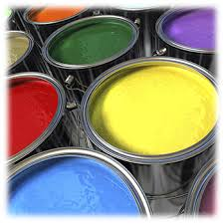
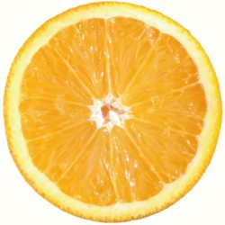
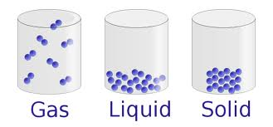
Physical properties
A physical property is a characteristic of matter that can be observed without changing the matter’s identity
You can see it without changing what you’re looking at into something else
Can be qualitative or quantitative

Slide 5
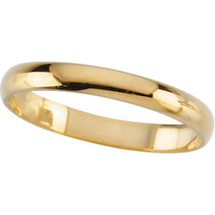
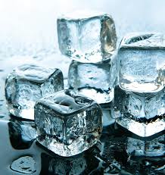
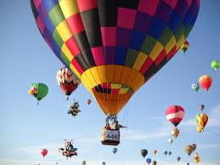
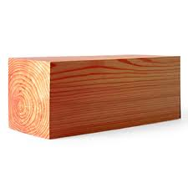
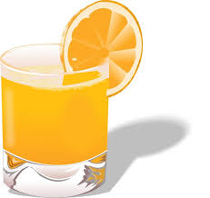
Examples of Physical Properties
Mass
Volume
Density
Color
Size
Melting and Boiling Point
Hardness
Odor
Taste
State of matter
Texture
Luster (shine)
Flexibility
Heat (thermal) conductivity
Electrical conductivity
Solubility
Shape
Viscosity
Ductility
Malleability

Slide 6
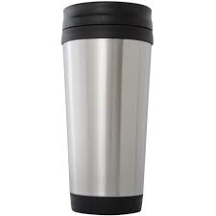
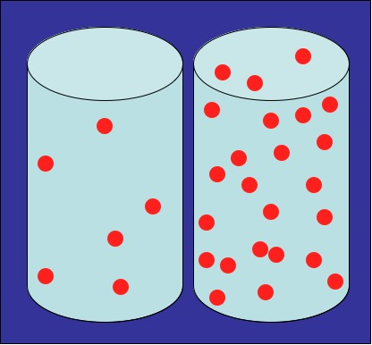
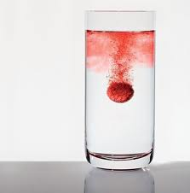
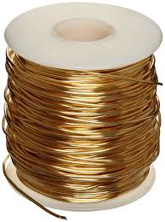
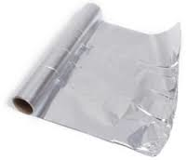
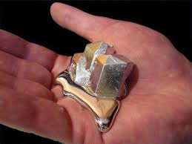
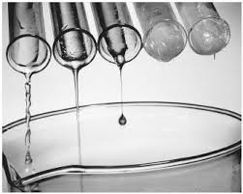
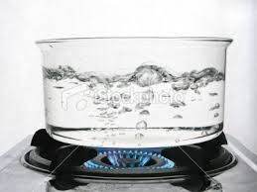
Thermal/electrical Conductivity | State | Density
the rate at which a substance transfers heat or electricity | the physical form in which a substance exists (solid, liquid, or gas) | mass per unit volume of a substance
Ductility | Solubility | Malleability
the ability of a substance to be pulled into a wire | the ability of a substance to dissolve in another substance | ability of a substance to be rolled or pounded into thin sheets
Viscosity | Luster | Melting/boiling point
the resistance of a gas or liquid to flow; “gooeyness” | the measure of shininess | the temperature at which a substance starts to melt or boil

Slide 7
Conduct an Investigation
Slide D
On the data table provided:
Observe each ingredient and record data that would help us tell them apart.
Observations of bath bomb ingredients
Add your data to a new notebook page titled:
Observations of Bath Bomb Ingredients
Be prepared to share these with the whole class.
Notes:
Decide what data to collect. Work with students to decide what data to collect from their tests, which will then be used to create a data table. Prompt them by saying, If we look at the different ingredients by themselves, what kind of data do we want to collect? We should decide as a class what kind of data we want, and then let’s set up a data table to use. Display slide D.
As a class, agree to collect data such as the color, smell, how it feels, how it moves in a petri dish, etc. Some students may suggest weighing the sample and recording the volume or how much they have of each. Students should set up a table in their notebooks to record these data. Their data table can be as simple as the one below.
Distribute materials to student groups. Each group of students should have a small sample of each of these ingredients:
baking soda
table salt
citric acid
powdered lemonade mix (sugar-free)
powdered lemonade mix (non-sugar-free)
Epsom salts
olive oil
coconut oil
sugar
corn starch
Students should examine each of the ingredients, make observations of each, and record them. Encourage students to record observations that will help them tell the ingredients apart later. This will encourage students to be detailed in their observations and to focus on accurately recording the properties of the ingredients. They will learn what a property is in this lesson.
Monitor groups as they make observations. As students are making observations, visit each group and encourage students to be detailed in their observations.✱ Prompt students to add more detail so they can tell the substances apart.

Slide 8
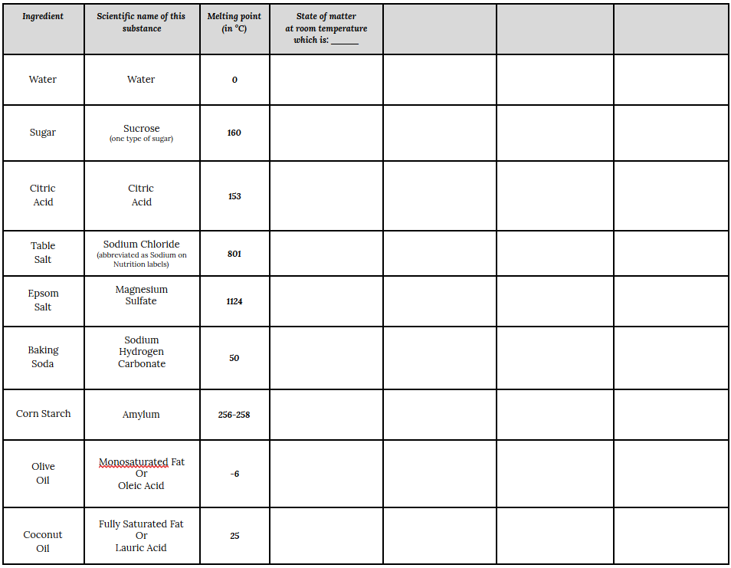
Slide J
How can we identify different ingredients?
Enter the state of matter here.
The first two columns are the common and scientific names of the different bath bomb ingredients.
The third column lists the melting point for each ingredient.
Notes:
Enter data in the data table and make sense of it. Display slide J (this slide is animated) and distribute Handout 2.
Tell students not to tape it in their notebooks yet because we will be adding to it first. Say, Let’s make sense of this data table. (Advance slide J.) Each ingredient name is in the first column. We have been calling all these things ingredients, but in science, they are identified as substances because they are all made up of the same type of material. So all these ingredients that are recorded in the first column are substances. Let’s add that to our Word Wall. Substances are made of one type of matter throughout. The second column is the scientific name of the different substances. Continue using a dialog similar to that below.
Add the word mixture to the Word Wall with the definition: a blend of two or more substances. Ask students to give you some examples of mixtures that they have worked with before. Add examples to the mixture card.
Enter the state of matter data. Show students that the next column on the data table gives the melting point. Advance slide J. You will talk more about the melting point later. Students may notice that many of the ingredients are solids at room temperature and have extremely high melting points. That property is not easy to measure in a school setting.
Advance slide J. Tell students to enter the state of matter of each ingredient in the column labeled “State of Matter.” Ask students why it is important that the room temperature be included in their data. Record the room temperature on the column heading. Tell students they only need to enter solid, liquid, or gas in the column.
Students may have noticed that the coconut oil melted in their hand. Encourage them to reason about this and compare their body temperature to the melting point. If matter is not on the Word Wall, put it there now with examples of states of matter. Matter is anything that takes up space and has mass.
Other connections to the data for states of matter can be brought out by asking questions similar to the ones below. Students may want to put “state of matter at room temperature” and “melting point” on sticky notes and add them to the Word Wall as additional examples of properties.

Slide 9
Slide C
Plan an Investigation
Discuss with your class
You team will receive a set of materials to observe.
How can we use the ingredients to help us figure out why the bath bomb makes gas bubbles?
Do you see any patterns across the ingredients?
What could we investigate?
Notes:
Ask students what we should do with this information. Display slide C. Say to students, OK, so now that we know what ingredients are in the bath bombs, how can we use this information to help us figure out why bath bombs make gas bubbles? Do you see any patterns that could help us design an investigation? Allow students to discuss this with a partner, and then ask for a few responses from the class. Students should suggest looking at each ingredient separately. Students may also suggest dissolving all of these ingredients by themselves in water to see if any gas bubbles form.

Slide 10
Conduct an Investigation
Slide D
Create a data table to list each ingredient you will test.
Observe each ingredient with water and record data.
Observations of bath bomb ingredients
Add your data to a new notebook page titled:
Observations of Bath Bomb Ingredients with Water
Be prepared to share these with the whole class.
Notes:
Decide what data to collect. Work with students to decide what data to collect from their tests, which will then be used to create a data table. Prompt them by saying, If we look at the different ingredients by themselves, what kind of data do we want to collect? We should decide as a class what kind of data we want, and then let’s set up a data table to use. Display slide D.
As a class, agree to collect data such as the color, smell, how it feels, how it moves in a petri dish, etc. Some students may suggest weighing the sample and recording the volume or how much they have of each. Students should set up a table in their notebooks to record these data. Their data table can be as simple as the one below.
Distribute materials to student groups. Each group of students should have a small sample of each of these ingredients:
baking soda
table salt
citric acid
powdered lemonade mix (sugar-free)
powdered lemonade mix (non-sugar-free)
Epsom salts
olive oil
coconut oil
sugar
corn starch
Students should examine each of the ingredients, make observations of each, and record them. Encourage students to record observations that will help them tell the ingredients apart later. This will encourage students to be detailed in their observations and to focus on accurately recording the properties of the ingredients. They will learn what a property is in this lesson.
Monitor groups as they make observations. As students are making observations, visit each group and encourage students to be detailed in their observations.✱ Prompt students to add more detail so they can tell the substances apart.

Slide 11
Slide E
What did we notice about the ingredients?
As a whole group, discuss what we observed and the patterns we noticed in the data.
What did we notice?
When you combined the substances with water, what did you observe?
Did we find any evidence that would help us figure out why the bath bomb produced gas bubbles?
How does that behavior compare with a bath bomb placed in water?
What should be our next steps?
Notes:
Bring the class back together as one group. Display slide E. When the students are finished with their observations, bring the class back together as one group. Say, What were some of your observations--what did you notice? Did you find any evidence that would help us figure out why the bath bomb produces gas bubbles?
Noting patterns in the data. Guide students to note patterns in the data, and categorize these using words/phrases that scientists also use to describe similarities and differences around different kinds of characteristics. Viscosity is one word that students might be unfamiliar with. It is not important if it doesn’t come up--but if it does, you can be prepared to identify the term later.
Students should note these observations as they collect their data. The substances in the bath bomb (that we had to start with) have characteristics that we can use to tell them apart (and also to determine what each one is).
They are liquid or solid at room temperature (different states of matter at room temperature).
The liquids flow differently (viscosity).
Some have different colors (color).
Some have a noticeable scent/smell, but others do not (odor).
One turned to liquid when touched (it went above its melting point of 76 degrees), while others didn’t change phase.
There were different amounts of stuff in each container (volume and mass).
As you monitor the groups, they may be describing these characteristics without knowing the name of the property. Ask students, Do you know what we call the way something smells? Do you know what we call the way something flows? This is just to get students to start thinking about these terms. After the word property is introduced, you may add these names of properties to the Word Wall.
Introduce the term, properties. Say, These ways of describing characteristics of matter [shown in bold above] are helpful for identifying what a substance is because they are constant for any sample of that substance, no matter the size of the sample. These are considered properties. Add, “Properties: characteristics of substances that do not change” to the Word Wall.✱
Say to students, So what about mass? What about volume? Are those properties? Why do you think that?
Start adding examples to the word “properties” on the Word Wall. Say, We just put the word “properties” on the Word Wall. Let’s add examples of all the properties we have worked with. We will write each property on a separate sticky note and stick them on or near the word “properties.” Are there examples we can add now? Let students suggest, write, and post the examples. Add the properties that students have observed so far (color, odor, melting point, etc.). If students noticed that the liquids flowed differently in the petri dish, you can tell them that this describes the property of viscosity. Have a student add viscosity as a property if it comes up. Make sure you don’t add things such as mass, volume, or size. These are not properties. The class can add examples of properties as they continue through the unit.

Slide 12
Slide N
Arguing from Evidence
Whole Group Discussion
What claim would you make about the ingredients interacting with water?
Do any of the individual ingredients react with water?
What evidence do we have?
Notes:
Facilitate a building understanding discussion. Present slide N. Ask students to read the questions to themselves first and think about them for a minute.
Point out that each question asks us to think about a different aspect of making an evidence-based argument, and that we will work with these three questions as a whole group.
Ask students to summarize the key parts of arguing from evidence based on this poster. Reference the poster you made in Lesson 2 about these two parts of arguing from evidence as needed.

Slide 13
Bath Bombs Lesson 4
Investigation Question: What Combinations of the Substances in a Bath Bomb Produce a Gas?

Slide 14
Slide I
Making Sense
When you combined the substances with water, what did you observe?
How does that behavior compare with a bath bomb placed in water?
Notes:
Report the results. Display slide I. Ask a few students to report what they saw happen to each ingredient when it was added to water. They can bring their labeled cups up to the front of the room and line them up on the front table as they report their results for other groups to see, if you wish. Ask students to also compare how this was the same or different from bath bombs interacting with water. Encourage students to add ingredients that they did not test to their data table. Each student should have data for each ingredient after everyone has shared.
Introduce or reinforce scientific vocabulary. Students will bring up that some of the ingredients dissolved in water. Ask students what it means to dissolve. Add the word “dissolve” to the Word Wall with the definition: when a solid dissolves in a liquid, the solid breaks apart into particles too small to see and it completely mixes with the liquid. While dissolving in liquids is not the only example, it fits our purposes here. You can return and add details to this definition as students perform additional experiments .
Students should agree from what they learned in previous years that when something dissolves in water, the water can be evaporated off and the original substance will still be there. (This should be something that was learned in 5th grade. However, if your students haven’t learned it yet, you may wish to take the time to ask how to collect evidence supporting the concept that when something dissolves in water, we can let the water evaporate and get the original substance back.) An example dialog is shown below.
Introduce the word soluble. Say to students, We have learned that some of the bath bomb ingredients dissolve and some do not. Does anyone know the word we use to describe if something dissolves? If something dissolves, it is soluble, and if it does not dissolve and is not soluble, then it can be described as insoluble. ✱ Some of the things you put in water only partially dissolved--the liquid looked milky or some of the material settled to the bottom or floated on top--these things are partially soluble. Ask students to name some things that were soluble, insoluble, and partially soluble. Add these terms to the Word Wall .
Say, Solubility is what we have been talking about, and that is another property. Can someone write this on a sticky note and put it near the word “property” on our Word Wall?

Slide 15
Slide D
Planning our Investigation
There were 8 different ingredients (besides water) in the homemade bath bomb recipes. Let’s get ready to test two ingredients at a time in water.
Coconut oil
Epsom salts
Sodium bicarbonate
Olive oil
Lemonade mix
Citric acid
Sugar
Starch
Work with your group
First figure out how many different possible combinations there will be for us to test.
Then discuss which combinations you are most interested in testing.
Notes:
Plan the investigation in small groups. Have students return to their regular seats. Present slide D. Give students about 3-4 minutes to form small groups and discuss the two bullet points on the slide.
Plan the investigation as a class. Have a few students share the predicted number of possible combinations.
Say, I have a chart showing these 10 ingredients in each row of a table that also lists them in each column. Let’s see if we can use it to reason out how many unique combinations there are for us to try.
Pass out a copy of the Progress Tracker to each student.

Slide 16
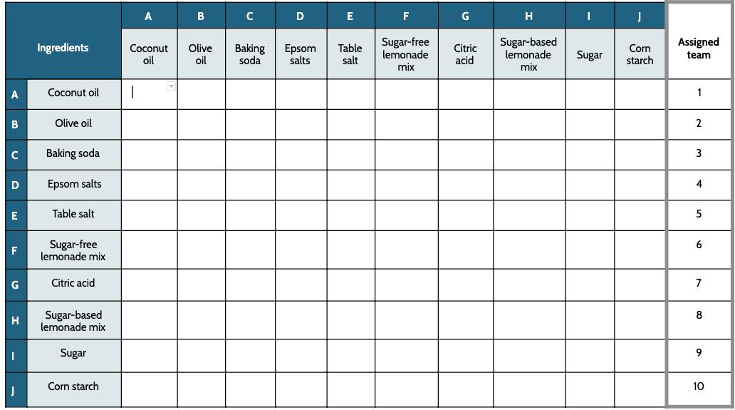
Slide E
Planning our Investigation
Work with your class
Highlight the row assigned to you in your copy of this table.
Notes:
Present slide E. Say, I was thinking we could have 10 groups, and each group could test all the combinations for each row in this table. For example, group 1 could test coconut oil, which is listed at the start of their row, with each of the things listed at the top of the ten columns.
Ask, does anyone see any combinations in this row that it wouldn’t make sense for this group to do?
Students will say, Coconut oil with coconut oil.
Point out that this sort of redundancy is in other rows too. X these out together as you identify them as a class, as shown below.
Say, This leaves 9 combinations for each group to try. I will give each group an ice cube tray like this one, which has 12 spots in it.✱ Hold up an ice cube tray to show the class.
Say, This will allow each group to test the 9 combinations they are assigned from their row and 3 other combinations that they want from anywhere in the grid. Let’s assign the groups now.
Assign group numbers to lab groups. Use slide E. Have students highlight the row that they are going to test.

Slide 17
Planning our Investigation
Slide G
Find pages 6-7: Combinations of Bath Bomb Ingredients with Water
Set up a 2 by 6 key describing which combinations you plan to test in each space in your ice cube tray. This key should be identical for everyone in your group.
Testing Combinations of Bath Bomb Ingredients
KEY
? | ? | ? | ? | ? | ?
? | ? | ? | ? | ? | ?
Notes:
Set up a key for the ice cube trays. Show slide G. Instruct students to work with their group to set up their key for which combination will go in each cell of their tray. Also have them attach their Data Table below their key.

Slide 18
Slide F
Planning our Investigation
Work with your group
Discuss which additional combinations you want to test.
Highlight those additional cells in your copy of this table.
Notes:
Pick additional combinations of substances to test. Show slide F. Then have students discuss with their group what three additional combinations they want to test. There are three people in a group, so allowing everyone a chance to weigh in on the one they want the group to try should result in everyone making a contribution to their group’s plan. Have groups highlight these choices as well in their handout.

Slide 19
Slide J
Making Sense of Our Results
If you found combination(s) of ingredients that caused bubbles to appear, add a “Y” to that cell. Then send one person from your group to mark a “Y” in the corresponding cell projected for the class (with marker, post-it, smartboard, etc…).
Notes:
Update the class data chart. In the last 3 minutes of this lab, show slide J. Ask all groups to update their chart with the letter “Y” in any cells that resulted in the appearance of bubbles and to send one person to the board to add sticky notes to the projected chart on slide J. Explain that if there is already a sticky note in that cell, that they should stack theirs on it, slightly off-center, so we can see where other groups got similar results.
Look for verification of results vs. conflicting results
Keep slide J projected with the sticky notes from all groups on the chart. Ask the whole class to identify patterns in the data. Ask students how we can use this chart to make sure that each combination yielded the same results for both groups that tested them. Students should say that there should be symmetry in the results.

Slide 20
Slide K
Navigation
Turn and Talk
Why do you think these particular combinations caused bubbles to appear?
The lemonade mix contains more than one substance. Do you have any predictions about the substances you might find in the ingredient label of the two lemonade mixtures?
Notes:
Discuss possible causes. Project slide K. Read the two questions, and have students turn and talk about these with a partner for a couple of minutes.

Slide 21
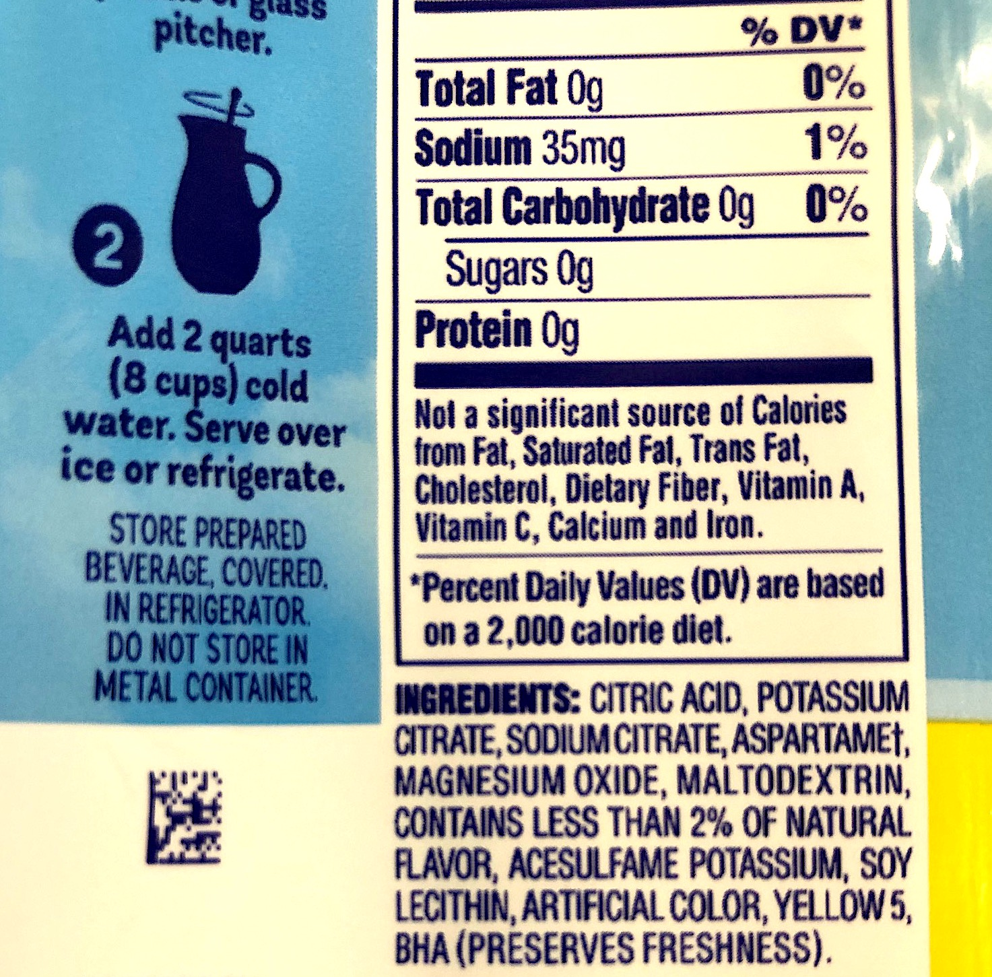
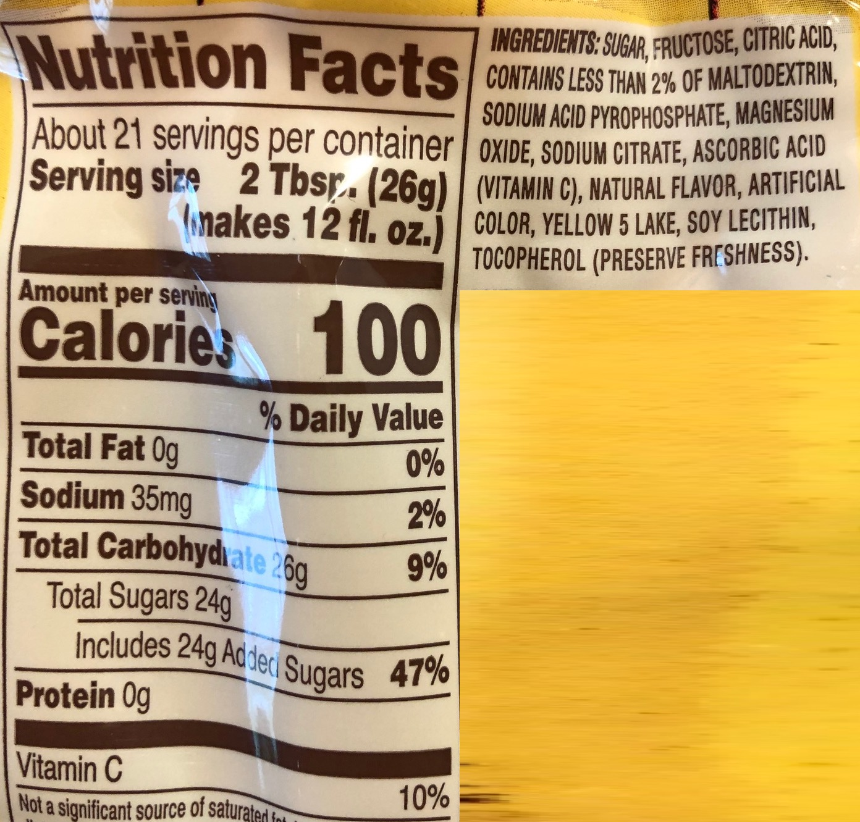
Slide L
On your own
What patterns do you notice between the substances listed in the ingredients in these mixes and the substances that resulted in bubbles appearing?
Analyzing Lemonade
Mix Labels
Lemonade Mix Label
Notes:
Analyze the lemonade mix ingredients. Tell students that you want them to analyze the ingredients from each of the two lemonade mixes on their own and start thinking about what this tells them that they can add to their progress trackers. Project slide L. Pass out copies of student reference with ingredient labels.

Slide 22
Slide N
Arguing from Evidence
Whole Group Discussion
What claim would you make about the key combination of substances that is interacting together to cause the gas bubbles to appear?
What do we know about the state of matter of those substances at room temperature?
What can we conclude about the gas in the bubbles? Is it one of the substances we started with, or is it a new substance?
Notes:
Facilitate a building understanding discussion. Present slide N. Ask students to read the questions to themselves first and think about them for a minute.
Point out that each question asks us to think about a different aspect of making an evidence-based argument, and that we will work with these three questions as a whole group.
Ask students to summarize the key parts of arguing from evidence based on this poster. Reference the poster you made in Lesson 2 about these two parts of arguing from evidence as needed.

Slide 23
Slide O
Arguing from Evidence
Whole Group Discussion
Can we restate what others said and explain why we agree or not? Do we agree or not?
Can we identify the use of evidence and/or scientific principles in their reasoning?
Can we explain why the information you heard counts as evidence and/or scientific principles?
What claim would you make about the key combination of substances that are interacting together to cause the gas bubbles to appear?
What do we know about the state of matter of those substances at room temperature?
What can we conclude about the gas in the bubbles? Is it one of the substances we started with, or is it a new substance?
Notes:
Then present slide O. Say, As we develop our ideas on these, I will follow up on the answers that people share by asking the rest of you to weigh in on what you hear.
Say, I will ask the first question in purple, and it will be about each of the questions in blue to the right, and the first question will be, “Can we restate what others said and explain why we agree or not?” Then I will ask if we all agree or not. For us to be able to answer either of these questions, we have to be able to hear the other ideas that people are sharing. That means we have to listen for understanding, and they have to speak clearly toward us so we can hear them.✱
Say, After we determine that, I will ask you to think about whether the information you heard referenced any evidence or scientific principles that we have agreed on. I will ask you to snap your fingers if you heard evidence and raise your other hand if you heard the use of a scientific principle. I will follow up by asking why or where you thought you heard use of either evidence or a scientific principle.
Although you may not have time to gather in a full Scientists Circle, have students turn their chairs so they can see others in the class, and others can hear their responses.
Start with talking about question 1.
Shift to talking about question 2 in blue. Read it aloud, and give students 30 seconds to think about their responses to it before taking volunteers.
Again, ask students to restate the arguments they heard. As students restate the argument, write it on poster paper for the whole class to reference.
Take a poll of how many students heard/saw the use of evidence. Do this again for the use of scientific principles that were written out. Ask students to explain which part was which and why.
Listen for responses such as:
When we said we saw that baking soda was a solid, citric acid was a solid, and water was a liquid, this was evidence because it is a summary of the data and was something we observed.
We know that the state of matter at room temperature is a property. And we know that properties are something that don’t change for the same type of substances. They are constant. These are restatements of parts of the scientific principles we are using when we say this sort of thing.
Shift to the last question in blue.
If students agree that they can’t be gases at room temperature, then skip the alternate activity callout here and keep going. If students suggest that these substances might be boiling, follow the alternate activity callout guidance.
Again, ask students to restate the arguments they heard. As students restate the argument, write it on poster paper for the whole class to reference.
Take a poll of how many students heard/saw the use of evidence. Do this again for the use of scientific principles. Ask students to explain which part was which and why.
Listen for responses such as:
When we said we saw the bubbles filled with gas and that we’ve captured the gas before to see that it took up space and had mass, even though the gas itself wasn’t visible, this all counts as evidence because it summarizes the data we collected. These are all based on the observations we took.
We know that the state of matter at room temperature is a property. And we know that properties don’t change for the same type of substance--they are constant. Because the properties changed, the substance must be something different than what was there before. All of these statements are ways of stating pieces of our scientific principles in different ways.
Post the poster papers you made with a record of the arguments created by the class as a reference for the next lesson.

Slide 24
Progress Tracker
Slide L
What did we all figure out during this investigation, and how will this help us figure out what causes bath bombs to behave the way they do?
Add the table below to your progress tracker.
What question were we trying to figure out?
Record what you figured out and how you learned it.
Progress Tracker
Question
What I figured out
Notes:
Add to the Progress Tracker. Display slide L. Individually, have the students add a row to their progress tracker to note what they have figured out and how this will help them figure out what causes bath bombs to behave the way they do. Encourage them to add what they have learned about solubility.
Do not score this version of the Progress Tracker, but rather, use it as a way to formatively assess what your students have figured out to this point. Sample ideas that students may list as to what they figured out are:
None of the substances made bubbles when added to water.
Some of the substances dissolved when added to water--these were soluble.
Some of the substances didn’t change in water, they just clumped up or formed a layer--these were insoluble.
A couple of the substances made the water turn murky or cloudy--these were partially soluble.
The mass didn’t change when the substances were added to the water, so nothing disappeared.

Slide 25
Slide P
Supplemental Boiling Point Data
Ingredient | Boiling point (in °C)
Water | 100
Citric Acid | 310
Baking Soda | 851

