Slide 1
Bath Bombs Lesson 2
Investigation Question: Where is the gas coming from?
Lesson 2

Slide 2
The Driving Question Board (DQB)
Slide A
What questions did we have about the gas bubbles?
Now let’s review our questions and ideas for investigation from our DQB as an entire group.
What questions did we have about where the gas bubbles came from?
What were some of the different ideas we had about where the gas bubbles came from?
Notes:
Gather at the DQB. As students arrive in class, have slide A displayed. Have students bring their science notebooks with them and gather at the DQB. Ask students to review their questions and suggestions for investigations as the class arrives.
Once everyone is at the DQB, get their attention by saying, We had a lot of questions and ideas about where the gas came from that caused the gas bubbles. Point out the questions that they raised related to this. Ask students what the two (or more) competing claims were for where the gas came from, referencing the initial consensus model as needed.

Slide 3
The Driving Question Board (DQB)
Slide B
What questions did we have about the gas bubbles?
Is the gas already part of the bath bomb? (Did the bath bomb dissolve/melt/erode to release the gas?)
Is the gas something new created from a reaction? If so…
Does the matter that makes up the gas come from something new or something we started with?
Notes:
Gather at the DQB. As students arrive in class, have slide A displayed. Have students bring their science notebooks with them and gather at the DQB. Ask students to review their questions and suggestions for investigations as the class arrives.
Once everyone is at the DQB, get their attention by saying, We had a lot of questions and ideas about where the gas came from that caused the gas bubbles. Point out the questions that they raised related to this. Ask students what the two (or more) competing claims were for where the gas came from, referencing the initial consensus model as needed.

Slide 4
Looking Closely at a Bath Bomb--Our Plan
Slide C
Our Question:
Are the gas bubbles coming from inside the bath bomb?
Whole Group Discussion
Before we investigate, we need to consider a few questions to make sure we can make sense of our results.
What do we need to measure? How /when should we measure it?
What evidence do we need to look for and record?
How will we know if the gas comes from inside the bath bomb?
Notes:
Plan the investigation. Begin this planning time by displaying slide N and writing the question we will investigate on the board: “Are the gas bubbles coming from inside the bath bomb?” Ask the class questions like those that follow.
Students should articulate that if the bag does not inflate after we crush the dry bath bomb, then it might mean that the gas bubbles that we see do not come from inside the bath bomb. If the mass stays the same in the sealed bag before and after the crushing, then no new matter was created. If the mass does not go down when we open the bag, then a measurable amount of gas was not released when crushing the dry bath bomb.
Lead the class in a discussion. The class will decide on a procedure to measure mass and then conduct the investigation. Encourage them to use ideas from their previous investigation of putting bath bomb pieces in water in both an open and closed system. Write the plan on the board so all teams can see it and follow it. An example would be:
Put a piece of a bath bomb in a sealable bag. Squeeze out as much of the air as possible and seal the bag.
Record the mass of the bag and its contents.
Crush the bath bomb, and be careful to not puncture the bag.
Record observation about the inflation of the bag.
Record the mass of the bag again.
Create a data table. Work with students to plan a way to organize their data in their notebooks.

Slide 5
Looking Closely at a Bath Bomb--Our Plan
Slide D
Our Question:
Are the gas bubbles coming from inside the bath bomb?
Develop a Hypothesis
Before we investigate, we need to attempt to answer our question and predict what we think will happen. Record your hypothesis in the space provided.
Remember…A hypothesis must:
Attempt to answer the question
Have an “If…then…” format
Be testable
Notes:
Plan the investigation. Begin this planning time by displaying slide N and writing the question we will investigate on the board: “Are the gas bubbles coming from inside the bath bomb?” Ask the class questions like those that follow.
Students should articulate that if the bag does not inflate after we crush the dry bath bomb, then it might mean that the gas bubbles that we see do not come from inside the bath bomb. If the mass stays the same in the sealed bag before and after the crushing, then no new matter was created. If the mass does not go down when we open the bag, then a measurable amount of gas was not released when crushing the dry bath bomb.
Lead the class in a discussion. The class will decide on a procedure to measure mass and then conduct the investigation. Encourage them to use ideas from their previous investigation of putting bath bomb pieces in water in both an open and closed system. Write the plan on the board so all teams can see it and follow it. An example would be:
Put a piece of a bath bomb in a sealable bag. Squeeze out as much of the air as possible and seal the bag.
Record the mass of the bag and its contents.
Crush the bath bomb, and be careful to not puncture the bag.
Record observation about the inflation of the bag.
Record the mass of the bag again.
Create a data table. Work with students to plan a way to organize their data in their notebooks.

Slide 6
What is inside a bath bomb?
Slide E
Work with a partner.
Look closely inside the bath bombs using the hand lens.
Talk about what you see.
Record your observations in the provided data table
What do you notice?
Notes:
Say, Let’s look inside a piece of bath bomb and see what is there. Display slide M to show the question and the instructions for examining the bath bomb. Allow students 2 minutes to examine their bath bomb and talk about what they see. Students should notice that there are air spaces in the bath bomb. Students will continue to wonder if the gas bubbles from the bath bomb come from this trapped air.

Slide 7
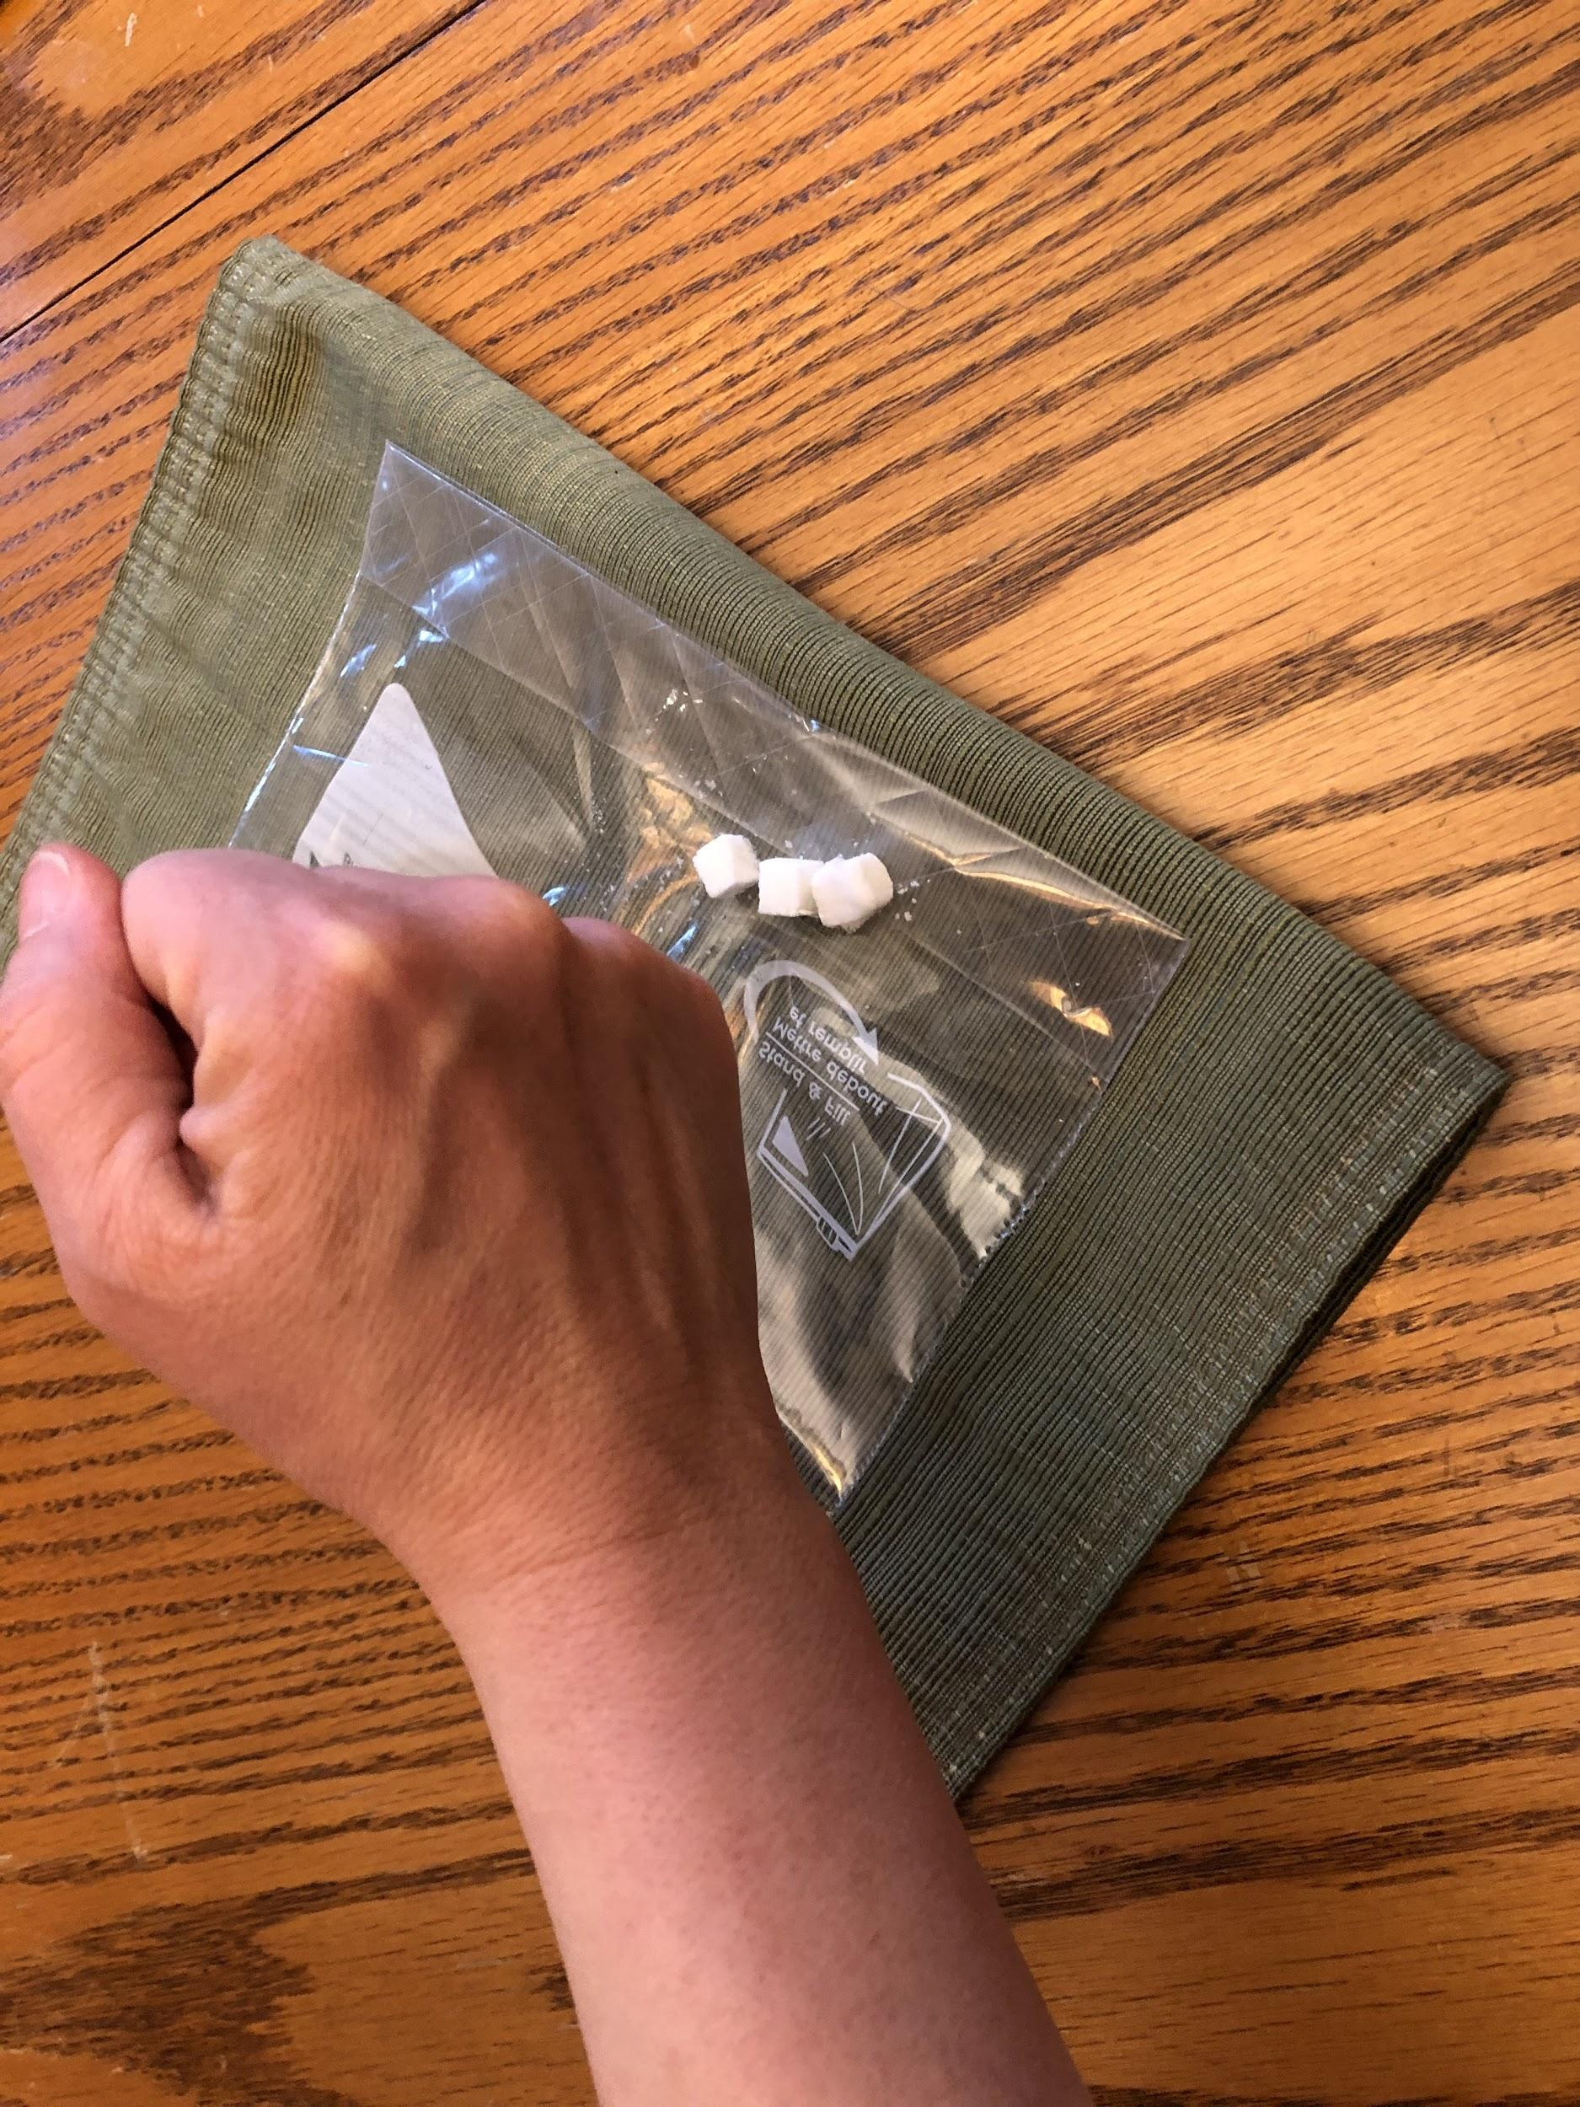
Investigating a Crushed Bath Bomb
Slide F
Important things to notice:
What happens to the bag when the bath bomb is crushed?
What happens to the mass after the bath bomb is crushed?
What happens to the mass when you open the bag?
Notes:
Investigate a crushed bath bomb. Display slide O. Students carry out their investigation to find out if the gas bubbles they observed come from inside the bath bomb. Assist students with their mass measurements, and remind them to use the same scale each time they take a measurement. Encourage students to use a book or some other large flat surface to crush the bath bomb. Using smaller objects such as a hammer may rupture the bag. Students should observe the following:
The bag does not inflate when the crush the bath bomb.
The mass does not change significantly when measured before and after crushing.
The mass does not change significantly when the bag is opened after crushing.

Slide 8
Investigating a Crushed Bath Bomb
Slide G
As a class, let’s make sense of our results from crushing the bath bomb.
What did we notice when we crushed the bath bomb?
What can we conclude from these results?
Notes:
Lead a short class discussion. Display slide P. Use this time to discuss the class results and ensure that students are making sense of their results. Example questions, student responses, and follow up are shown below.
Consider the lesson question. Ask students, Can someone remind us of the lesson question? Students should recall that the lesson question is, “Where did the gas come from?” Add Crushing a Bath Bomb to the list you started on the board earlier. (Investigating Gas from Bath Bombs was the first list.)
Ask students, What did you learn that will help you answer the lesson question? What can I add to this list? Statements will include
The mass did not change before and after crushing.
The bag did not inflate.
When we opened the bag, the mass did not change.

Slide 9
Strong Arguments and Explanations Include...
Slide H
1. A claim that answers a question.
2. Strong arguments are supported with:
A. Evidence = data and observations that we use to support the claim.
AND
B. Reasoning = explaining what these data and observations mean by connecting them to agreed upon scientific principles.
Notes:
Point out to students that they are now using a combination of two key features that are important to use in an evidence-based argument. Display slide R. (This slide is animated.) They are (a) referencing specific data/observations to use as evidence and (b) explaining what these observations mean by connecting them to agreed upon scientific principles and ideas. Emphasize that these are two key features of a strong evidence-based argument that we want to practice in all future arguments we will write.
Highlight key ideas of what makes a strong and convincing evidence based argument. Make note of these on a highly visible space in your classroom. Use the underlining and yellow highlighting shown in the poster to emphasize two pieces of it.
What we want to do when we are arguing from evidence or writing a scientific explanation: (advance slide R).
Make a claim that answers the question.
Back it up with:
Evidence = referencing related data/observations that support it
Reasoning = explaining what these observations mean by connecting them to agreed upon scientific principles
Emphasize to students that a convincing scientific argument connects these two main parts, evidence and reasoning, in a way that helps support the claim ✱
Revisit the lesson question. This slide is animated, and you will advance the slide later. Ask students, OK, so what question were we trying to answer here? Students should respond with the lesson question, Where is the gas coming from? Ask students if this evidence will help them answer the lesson question. They should recognize that it does. Ask if they have anything to add to the lists that they learned from their investigations. As students offer claims,✱ challenge them to cite evidence for their claim. Challenge them to use a related scientific principle as they support their claim. This discussion will prepare students for writing their own arguments at the end of the lesson.

Slide 10
Navigation
Slide I
What other ideas do you have about the gas from
a bath bomb?
What should we investigate next?
The gas is created from a reaction
Is the matter that makes up the gas created from something new or something we started with?
Notes:
Link to the next activity. Direct the class’s attention to the suggestions for investigations from the first lesson. Ask students, What other investigation ideas did you have that will help us figure out more about the bath bomb and the gas bubbles it produces? Students may suggest several different investigations, but one will be to crush the bath bomb to see if the gas was trapped inside. Display slide K. They will have the opportunity to investigate this in the next class.

Slide 11
Plan the Investigation
Slide J
What do we need to measure?
How should we measure it?
When should we measure it?
Open or closed system? Or both?
Our Question:
Is the gas coming from the bath bomb already there to start with?
Investigating Gas from Bath Bombs
Add your ideas to a new notebook page titled:
Investigating Gas from Bath Bombs
Notes:
Discuss and plan the investigation. Display slide B. Work with students to plan how they will investigate whether the gas that is coming from the bath bomb is already there to start with. Encourage them to test by adding a piece of bath bomb to water first in a closed system to trap the gas. Tomorrow (day 2), we will investigate crushing the bath bomb in both an open and closed system. Ask them how that might help us figure out whether the gas coming from the bath bomb is already there to start with.
Say, The question we are trying to answer with this investigation is: Is the gas coming from the bath bomb already there to start with?
Recall prior learning about gases. Point out that we have developed an initial class consensus model for the gas in the bubbles, and we decided to include particles in it. This was something we also did for the other forms of matter in the system, such as the bath bomb and the water.
Ask, What else do you know about gases? Pose questions to help students recall what they have figured out in previous units about gases. Use prompts such as:
What sort of things did you figure out about them in the cup unit or the weather unit?
What sort of evidence did you collect to determine whether gas was escaping from a system like the cup?
What sort of thing did you do in the weather unit to see what air does in a closed system when you heat it or cool it?
Several ideas about gases may surface, based on their prior experiences with OpenSciEd unit 6.2 (the cup unit) and unit 6.3 (the weather unit) in 6th grade. These include:
gases take up space,
gases have mass, and
gases are a state of matter.
Record student ideas. Students may also add ideas such as gases float, or particles in gases are far apart. Accept all answers and record all ideas but continue the discussion until you obtain the three in the bulleted list from student discussion. Make sure that these three are on the list.
Poll the class. As students offer these ideas, ask the class if they agree, disagree, or are not sure with a show of thumbs up, thumbs down, or thumbs sideways for each statement. Make note of their responses to compare to their responses when you poll the class again.
Decide on the data to collect. You will work with the class to plan and conduct this investigation as a class. This scaffolding will support students as they plan and then conduct an investigation on day 2 of this lesson. Lead the class in a discussion to decide what data is important for us to collect. See the sample prompts and responses below.
Use both a sealable bag and a plastic bottle for the closed system. Using the sealable bag will allow students to gather evidence that a lot of gas is produced because the bag inflates. However, mass measurements will be affected by a container with a changing volume, such as a bag, and therefore, they are affected by the buoyancy of the bag. The bag might come unsealed if too much gas is present. Use the suggested prompts below to encourage student ideas so that the design will surface.
Suggest to students an efficient way to conduct the investigation. Students do not need to conduct the investigation twice for an open and closed system. Students can obtain the mass of the bottle before and after the reaction (with the cap on). Then carefully remove the cap to release the gas while they are still at the massing station for the open system. Once the gas has escaped, they can obtain the mass using the open system. Students should note that they can use the beginning mass for the closed system as the beginning mass for the open system since no interaction has occurred or gas bubbles have formed.
Set up a data table. Work with students to organize their data collection.✱ Ask students, What data do we need to collect and how should we organize it?

Slide 12
What would we see if we found out that...
Slide K
...the matter that makes the gas is brand new stuff?
What would the bag/bottle?
What would happen to the mass?
They would inflate
It would increase
...the matter that makes up the gas is NOT new stuff?
What would happen to the mass in a closed system?
What would happen to the mass in an open system?
It would stay the same
It would decrease
Notes:
Encourage students to link the science ideas with possible outcomes before the investigation. Display slide D. In this investigation, students will see that the mass of the closed system does not change, but that of the open system does change. This shows that because the mass doesn't change in the closed system, the matter that makes up the gas must have come from something they started with. Get students thinking about what the data will mean before they investigate by asking questions similar to the following. Record their ideas on a piece of chart paper or on the board.

Slide 13
Recording Data
Slide L
Add your data table to a new notebook page.
Investigating Gas from Bath Bombs
System | Starting mass (g) | Ending mass (g) | Change in mass (g) | Observations
Closed
Open
Notes:
Display slide C. This slide is animated. Do not advance the slide to show the data table unless you are doing the alternate activity. Work with students’ ideas about collecting this data. Students should suggest collecting mass before and after the bath bomb is put in water. They should also suggest obtaining the mass for an open system. Students should include a space for recording other observations, such as how the bag looks after mixing the bath bomb and water and the “feel” of the plastic bottle. As students construct the table, copy it on the board and encourage students to turn their notebooks to the landscape position and use a full page.
Use this data table if time is running short. Should you choose to allow students to construct their own data table, the data table should be similar to the one shown below. Advance slide C and show the data table only if you choose not to have students develop their own tables. Have students turn their notebooks to the landscape position and copy this data table using a full page.

Slide 14
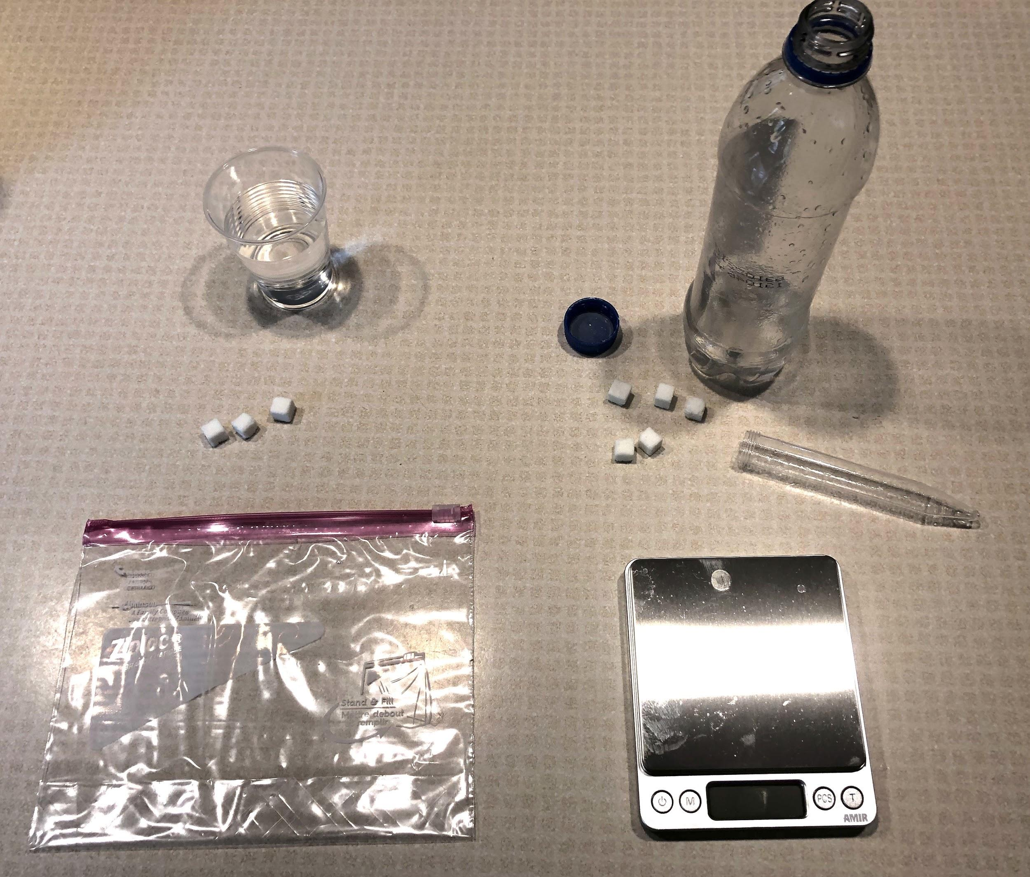
Investigating the Gas from Bath Bombs
Slide M
You will need:
resealable bag
100 mL of water in plastic soda bottle with lid
100 ml water in small cup
long plastic tube
8 mini cubes of a bath bomb (you will use three in part 1 and five in part 2)
electronic balance
Notes:
Do this investigation as a class. Engage different students in the tasks of measuring mass, mixing, and adding things to the bottle and bag. All students should be recording data in their data tables. Use slide E for students to gather materials for you to use and slides F-H when you and the students are conducting the investigation. Test the bath bomb and water in the resealable bag first (without mass measurements), and then move on to the plastic bottle test.
If you can do them simultaneously, you can test different recipes of the bath bomb and a store-bought bath bomb. However, don’t do them one at a time because it will take too much time.

Slide 15
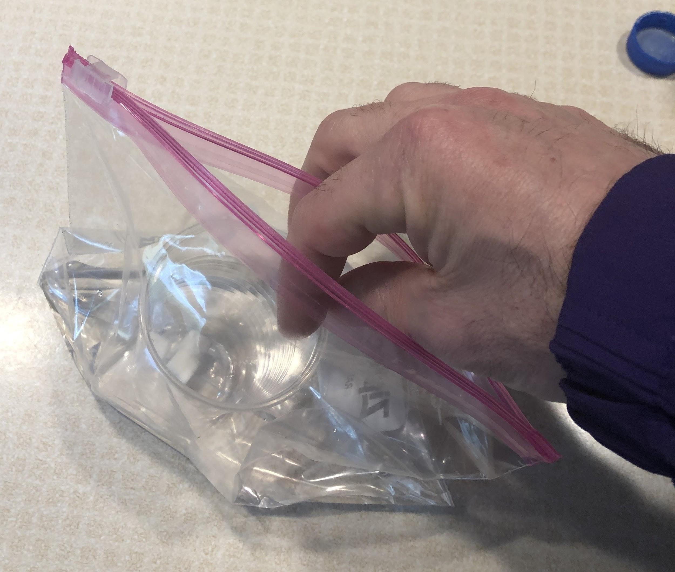
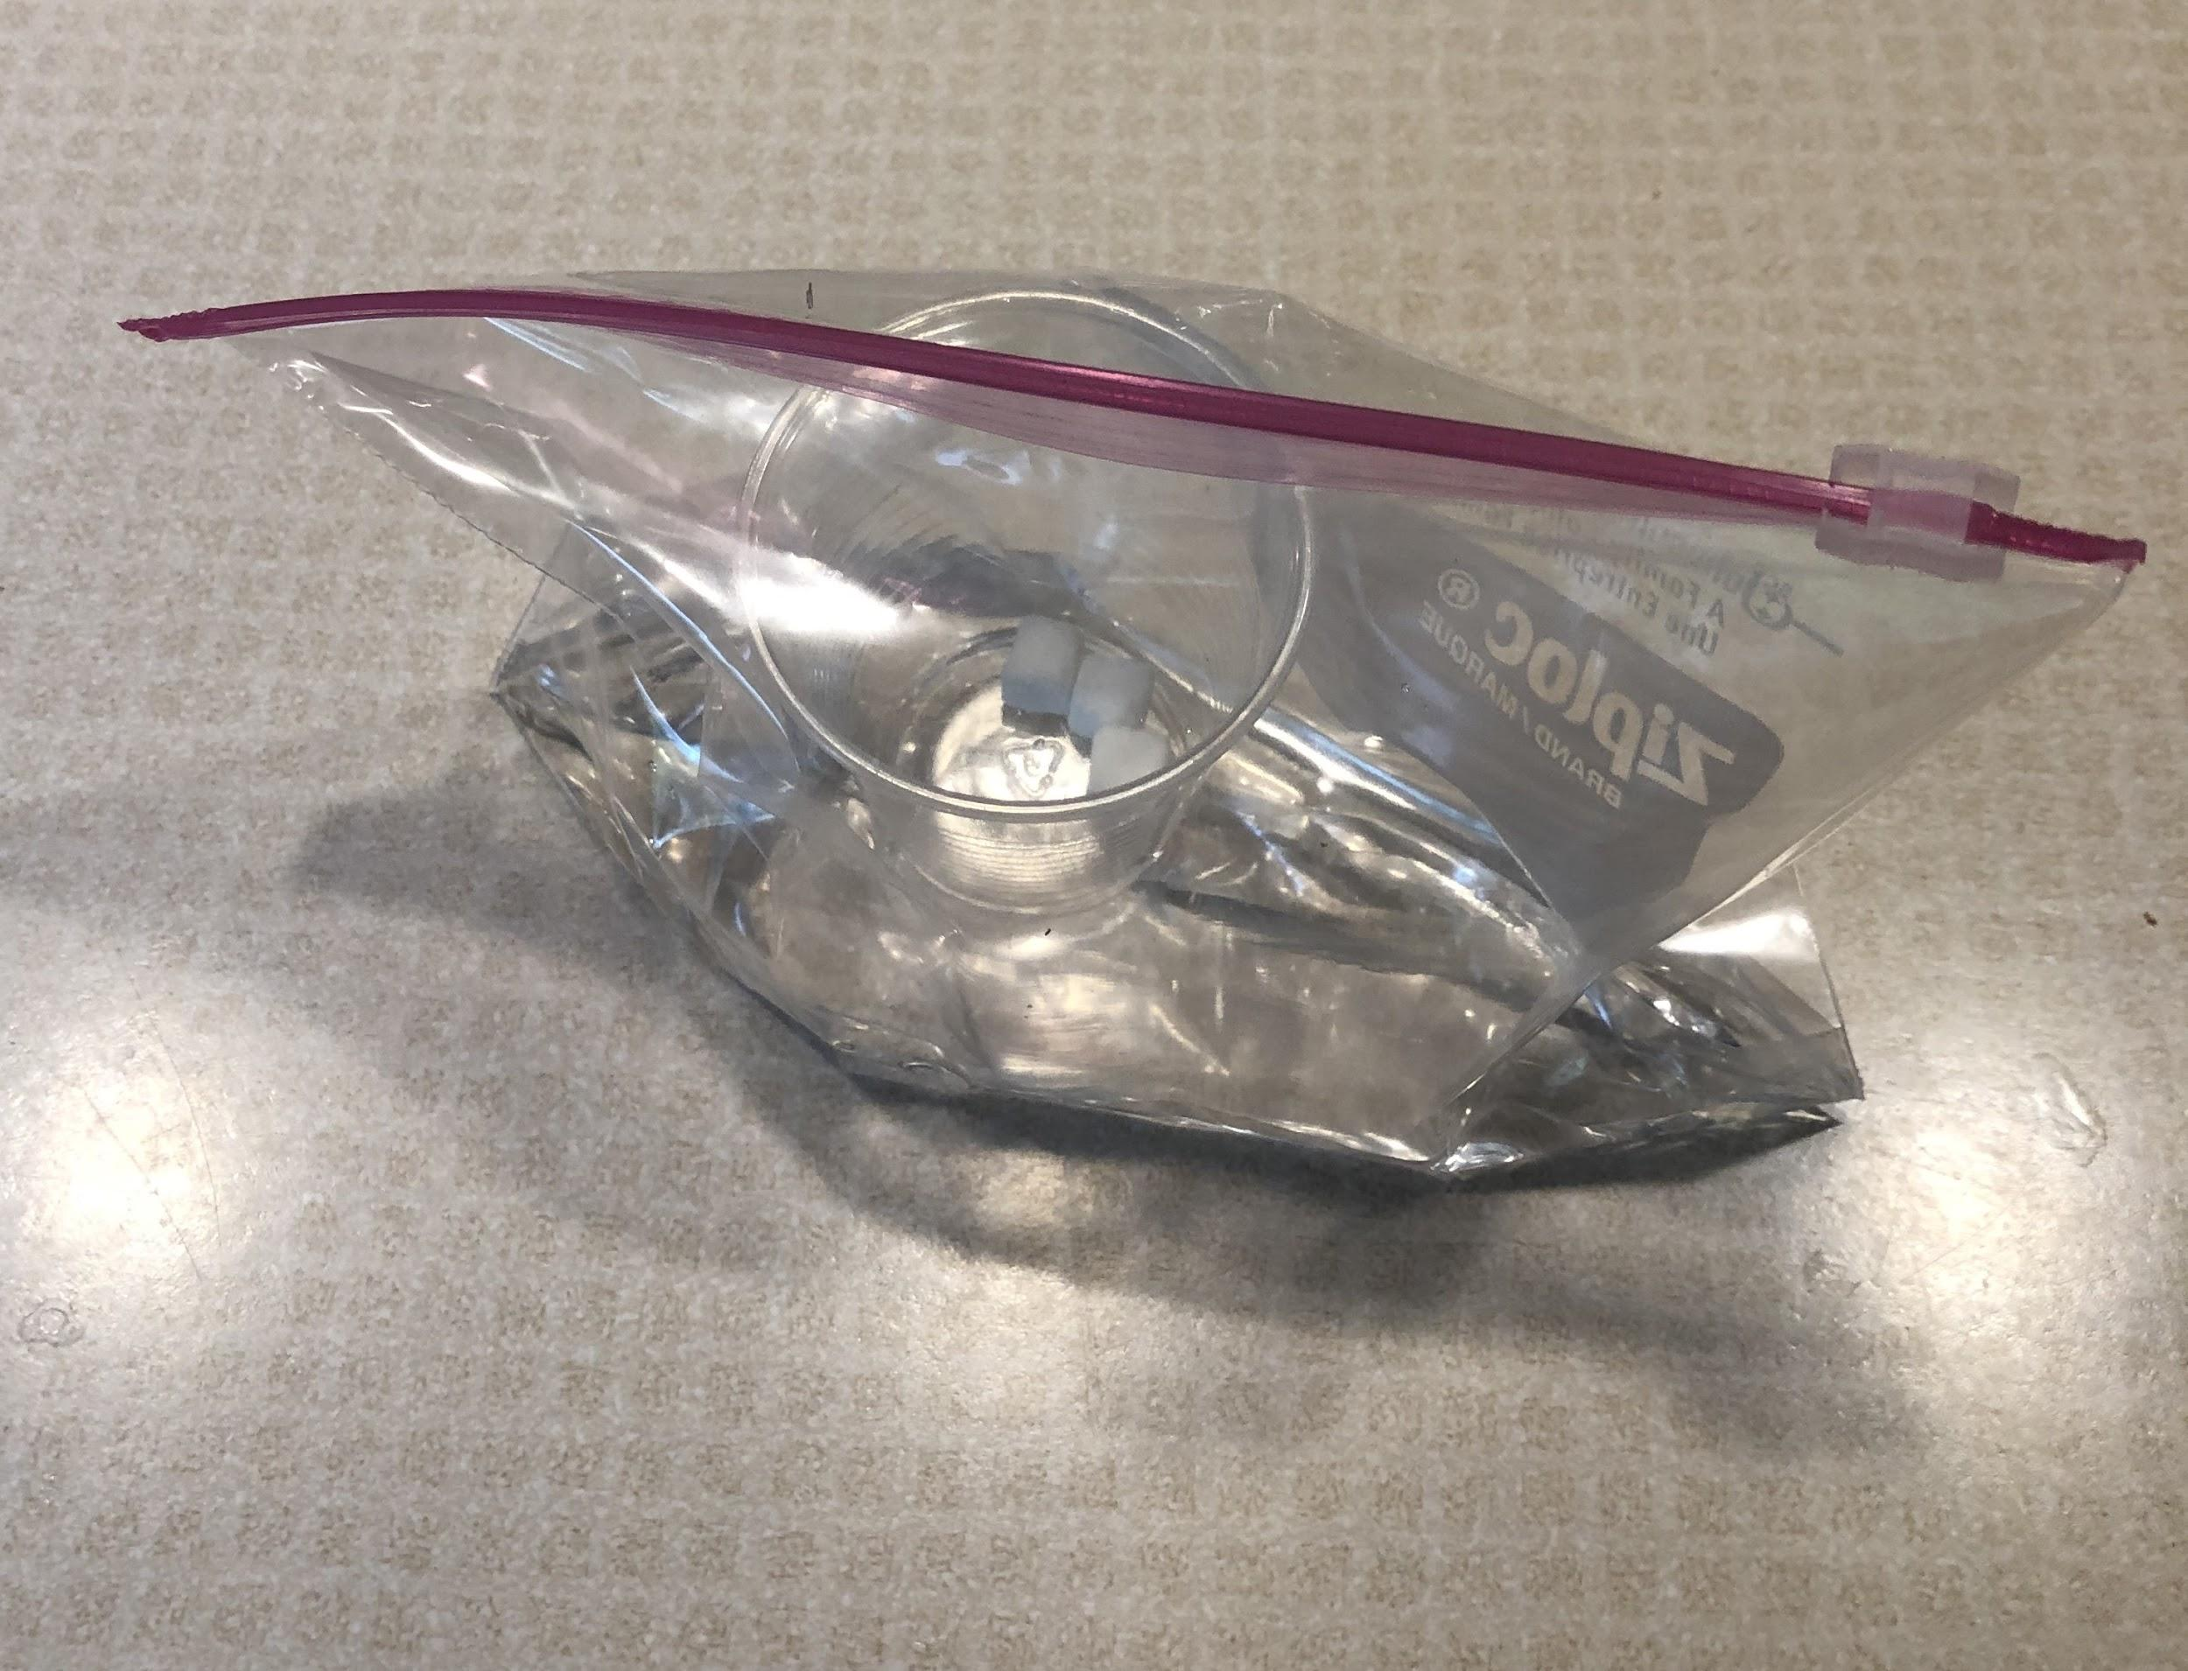
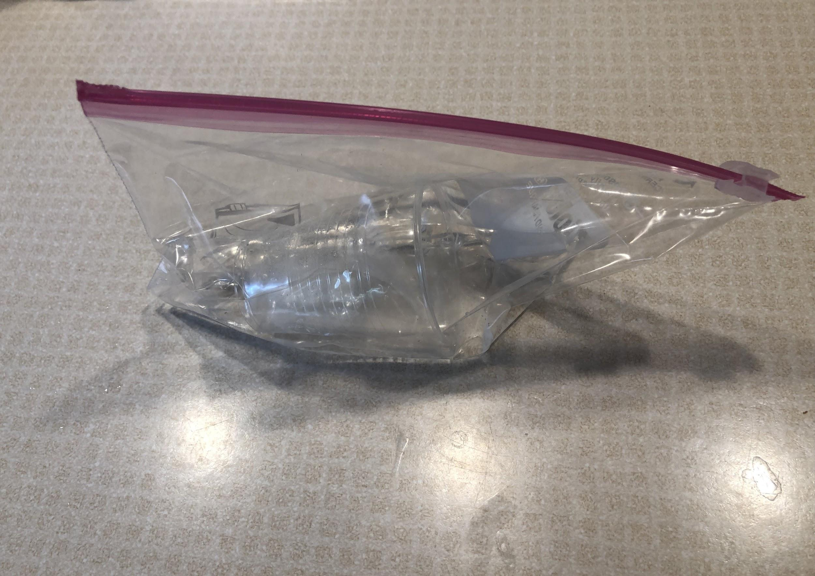
Investigating the Gas from Bath Bombs
Slide N
Lab Procedures
Part 1
Pour 100 ml of water into a resealable bag.
Dry out the cup. Place thee bath bomb pieces inside the cup. Place the cup inside the resealable bag. *Do not let the bath bomb pieces and water mix yet!
Squeeze out as much air as possible and seal the bag.
Keeping the bag sealed, tip the cup to mix the water and bath bombs.
Notes:
You can follow this protocol to test a bath bomb in the plastic bottle and record the mass.

Slide 16
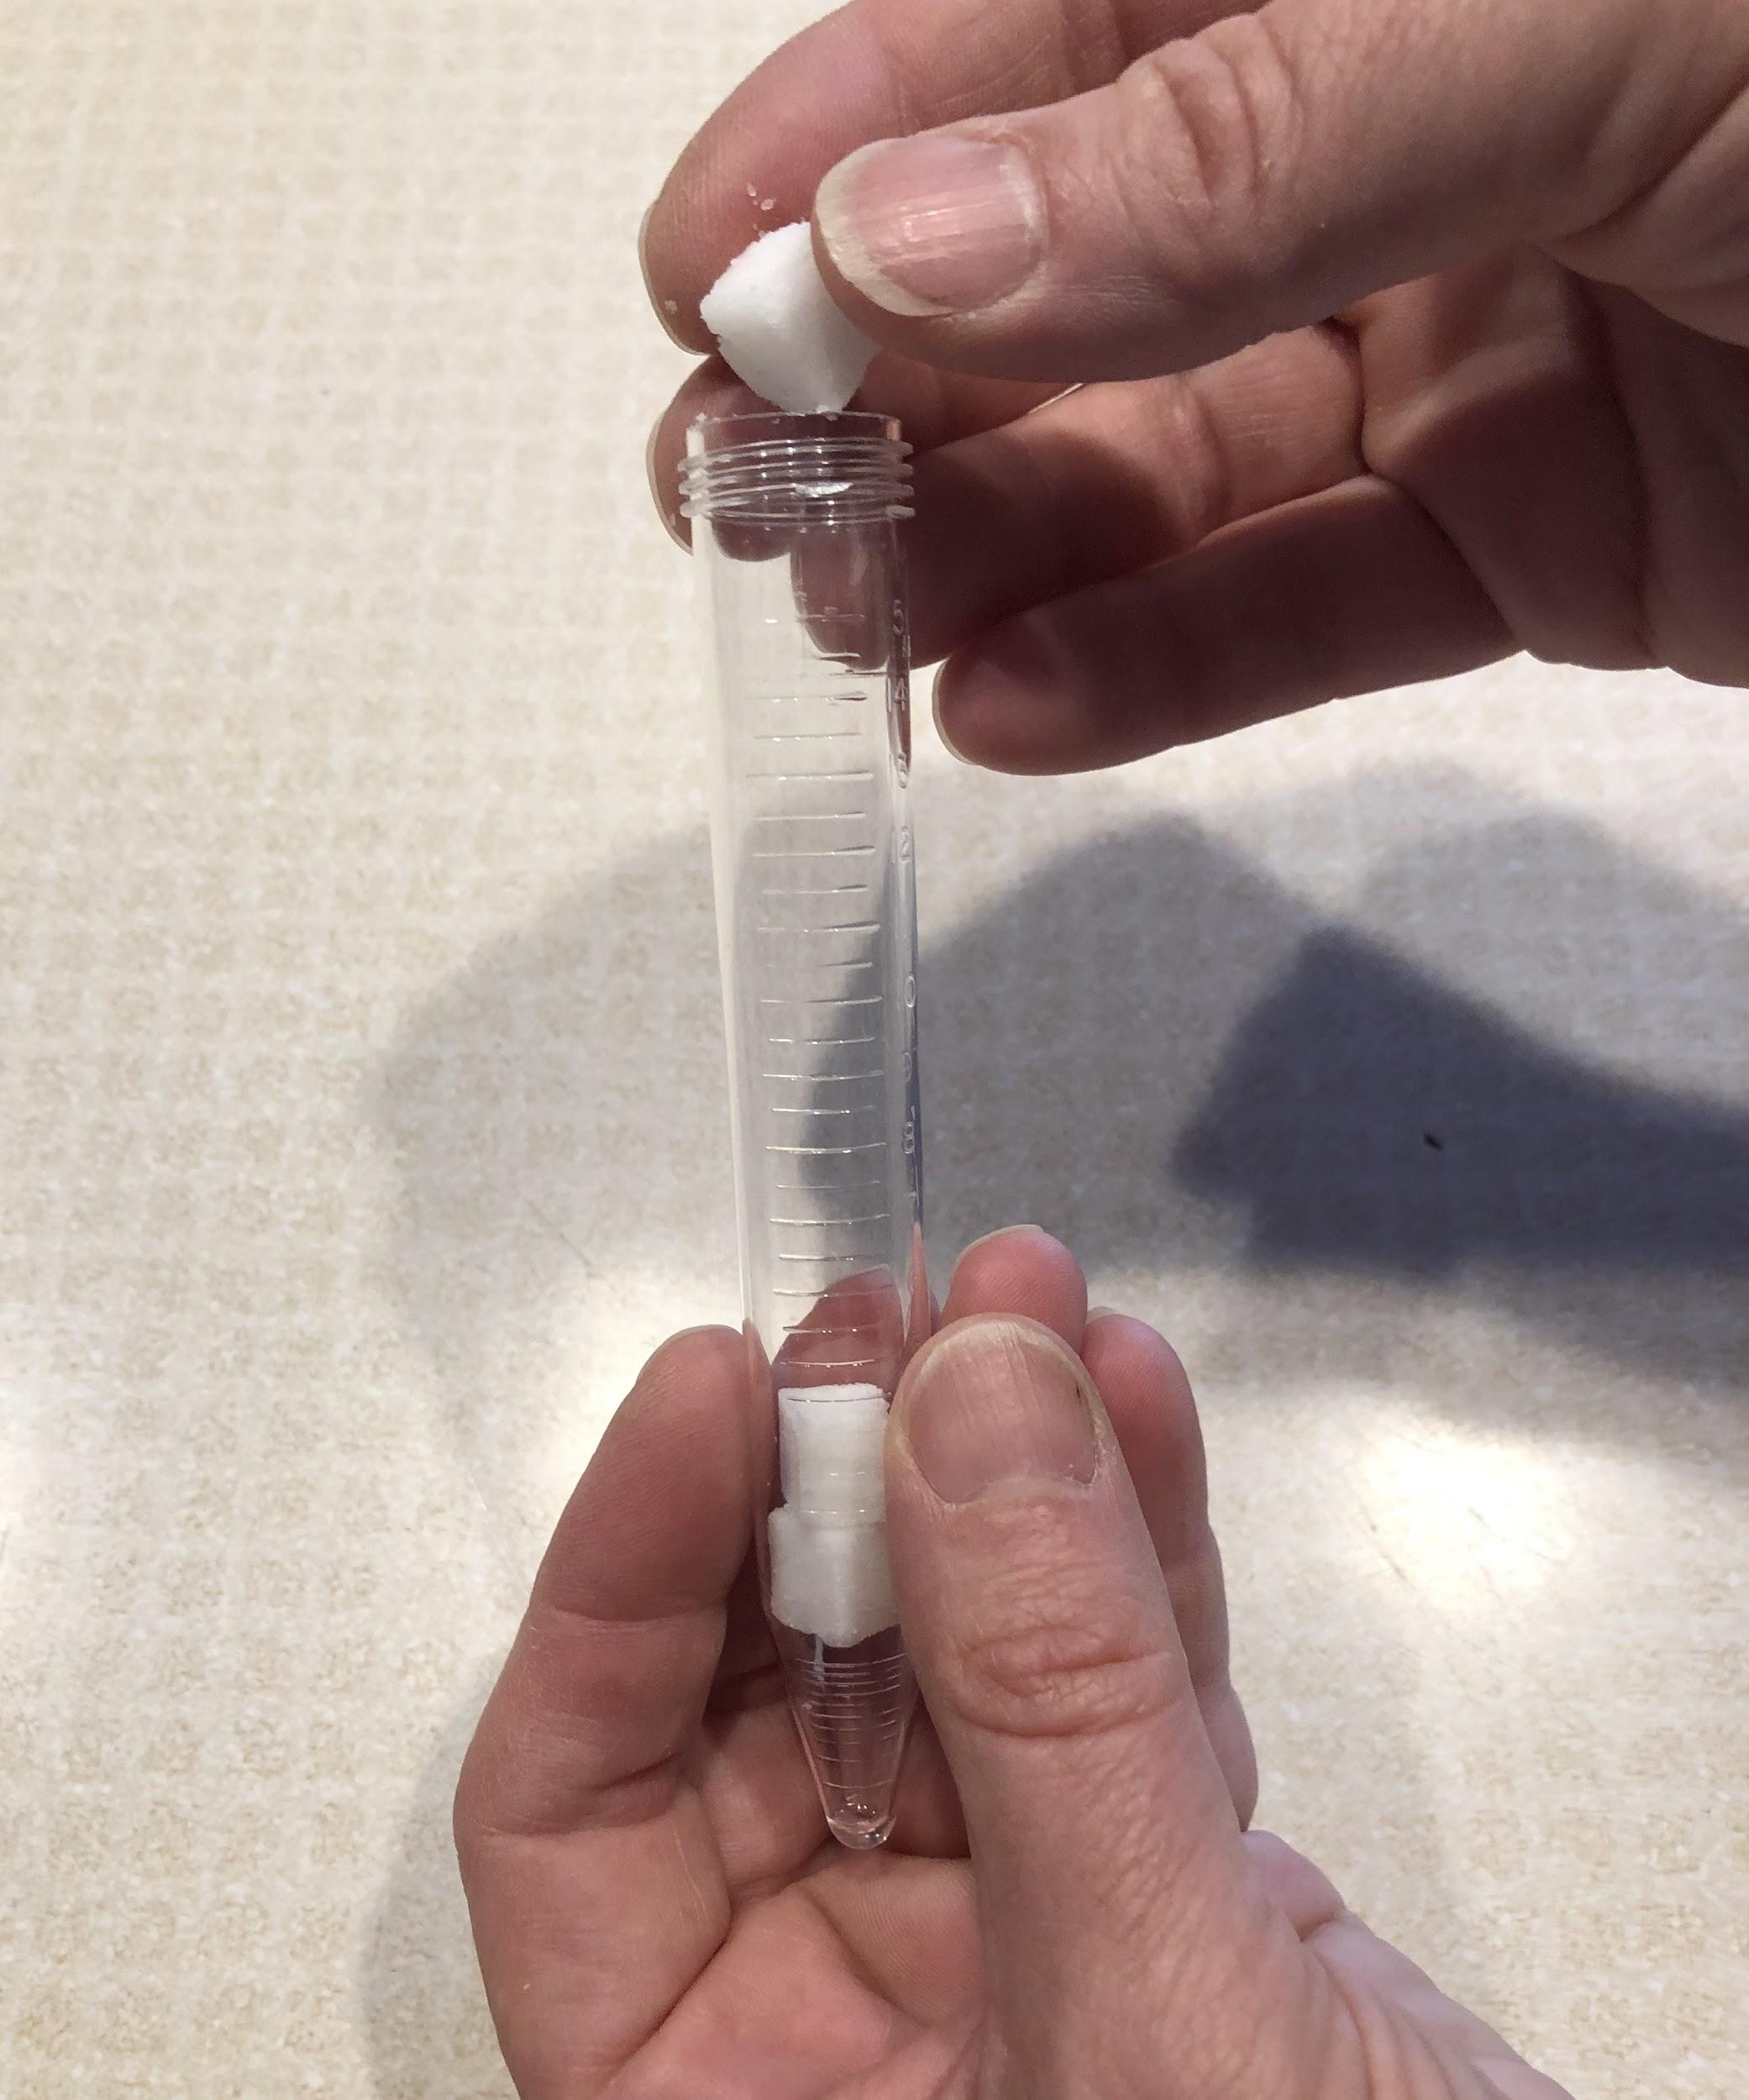
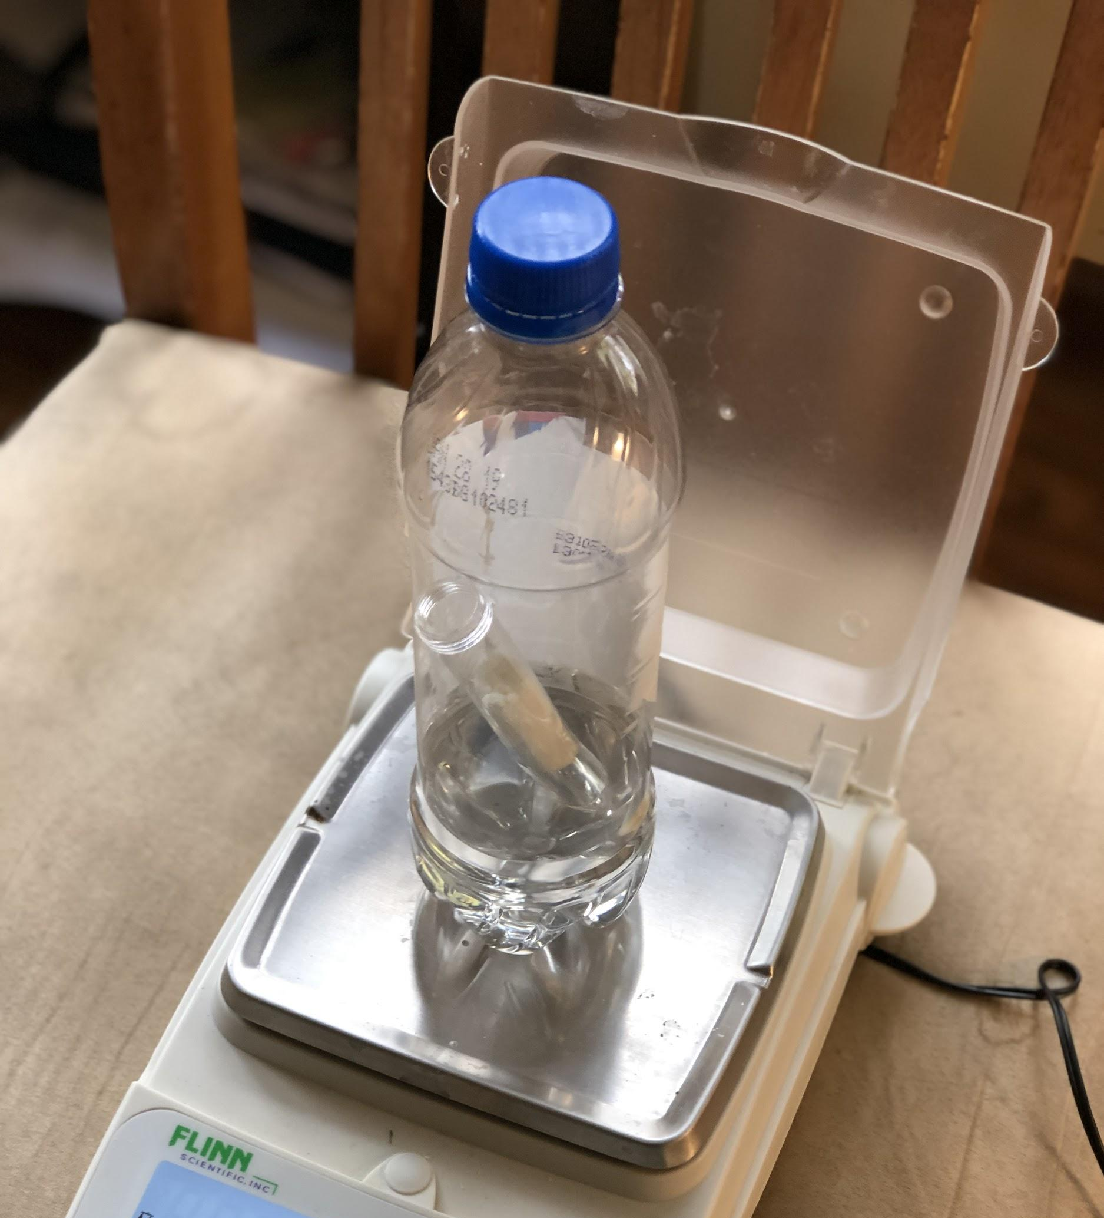
Investigating the Gas from Bath Bombs--Closed System
Slide O
Lab Procedures
Part 2
Add 100 ml of water to the plastic bottle.
Fill the tube with bath bomb pieces.
Carefully place the tube in the bottle with water. *Do not let the bath bomb and water mix yet!
Cap the bottle.
Measure and record the mass of all of the beginning materials.
Notes:
You can follow this protocol to test a bath bomb in the plastic bottle and record the mass.

Slide 17
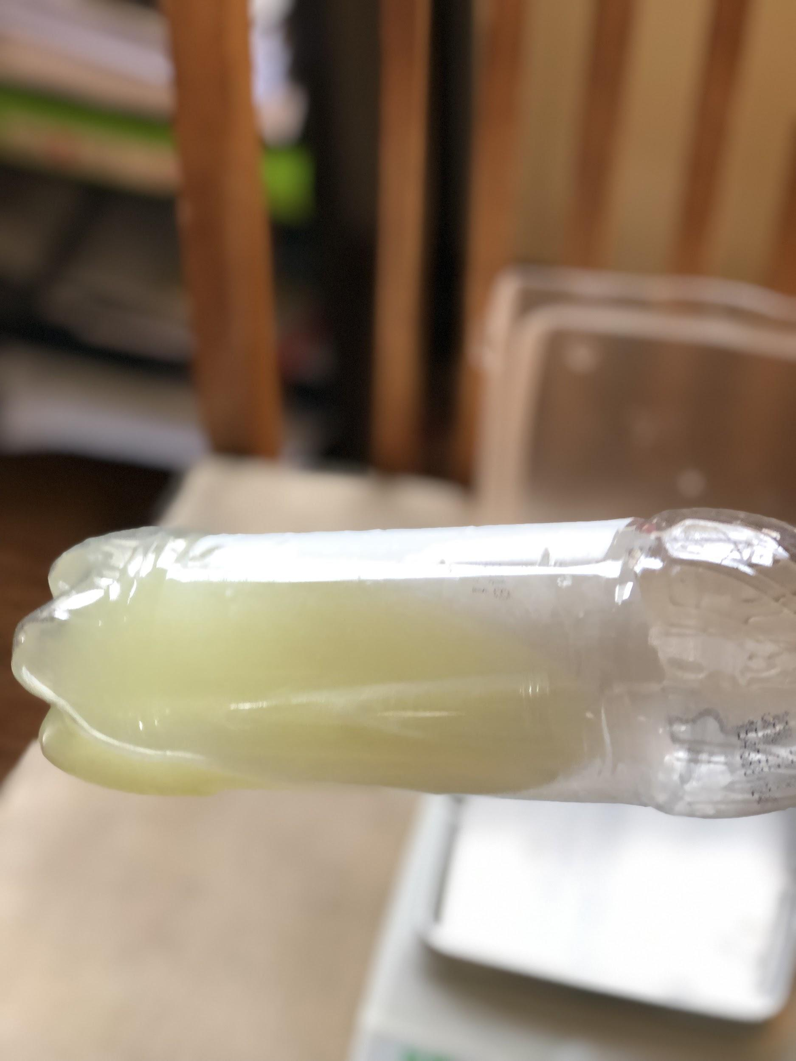
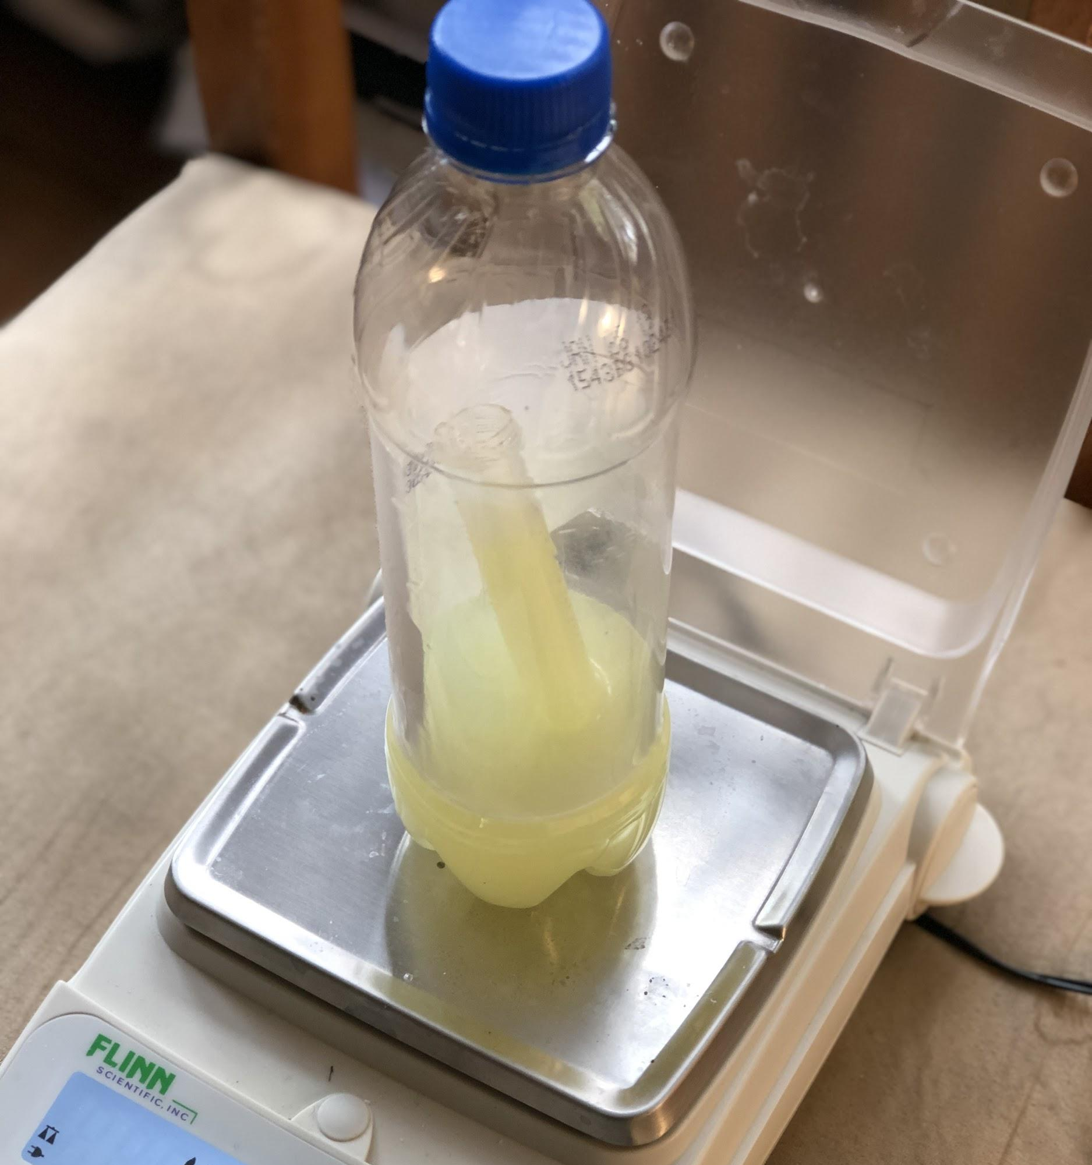
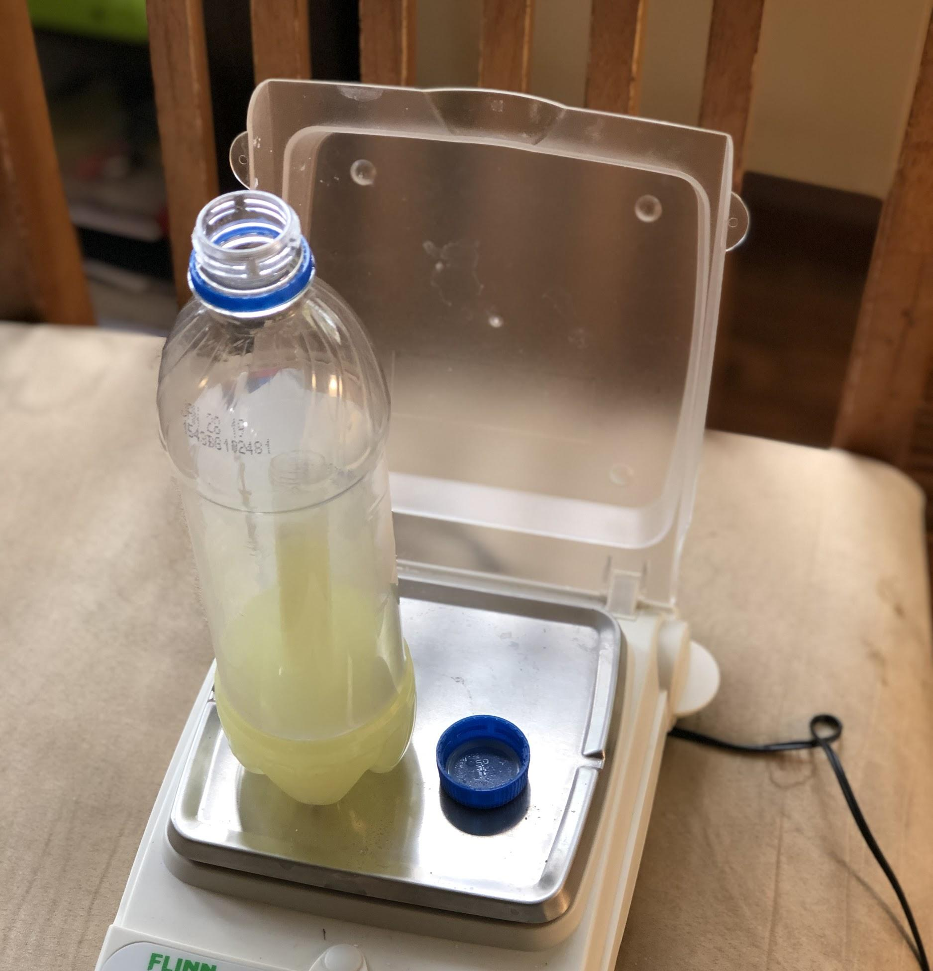
Investigating Gas from Bath Bombs--Both Systems
Slide P
Lab Procedures
Part 2 (continued)
Shake the bottle to mix.
Record observations.
Measure and record the mass.
Remove the lid from the bottle.
Measure and record the mass.
Notes:
You can follow this protocol to test a bath bomb in the plastic bottle and record the mass.

Slide 18
What did we learn about the gas in bath bombs?
Slide Q
Investigating Gas from Bath Bombs
What did we notice about our data?
What does the data tell us about where the gas comes from?
Notes:
Build understanding and make sense of the data. Gather students in a Scientists Circle and lead a discussion to build understanding. Display slide I. Lead the class in a discussion about their data and observations related to what they learned about the gas from a bath bomb. Remind them of their ideas about what they could learn from the data by referencing this poster that was created before the experiments:
Record key findings and principles. As students share, record key findings on the board. Also record any science principles they mention. Tell students they do not have to write these down, and that you are just recording things that they share in the discussion. Students should have observed no significant change in mass in the closed system. They should have also noticed that there was a significant mass loss when the closed bottle system was opened.

Slide 19
Slide R
Sensemaking: Making a Claim
Discuss as a class
What question have we been trying to figure out?
What is a claim?
Discuss with a partner
Choose one of the following claims that you feel our evidence best supports and discuss with a partner why you chose that claim.
Claim 1: The gas was already trapped in the solid bath bomb and was released when the solid bath bomb broke apart in water.
Claim 2: The gas comes from some combination of the matter in the water and/or the matter in the solid bath bomb.
Claim 3: The gas comes from some other matter (not the water or the bath bomb).
Notes:
Choosing a claim. Remind students that the question we are trying to answer is the lesson question, “Where did the gas come from?” The brief answer we would give to this question is our claim. Later in this discussion, the term “claim” will be further addressed . Have students work with a partner and pick one of the three claims shown on slide Q.
Discuss claims with a partner. After students respond, they should choose the claim that they think our evidence best supports and then discuss their choice with a partner. They should discuss how the evidence from all of our investigations supports that claim. They should also discuss evidence that counters the other two claims. These claims are presented on slide Q:
Claim 1: The gas was already trapped in the solid bath bomb and was released when the solid bath bomb broke apart in the water.
Claim 2: The gas comes from some combination of the matter in the water and/or the matter in the solid bath bomb.
Claim 3: The gas comes from some other matter (not the water or the bath bomb).
Surfacing ideas. These ideas will likely come up in your discussions from the two investigations students did during this lesson. If these ideas have not surfaced, continue the discussion and probe student ideas until they do. These responses are coded, as you have coded the student responses from the discussion by showing underlined evidence and highlighted pieces of scientific principles. These lists here summarize the type of information that should surface from the discussion.
Investigating Gas from Bath Bombs
Gases are matter and have mass.
The gas must come from something that is already there--it is not brand new matter.
We know that it came from something already there because the mass did not change in the closed system.
Another piece of evidence was that when we opened the closed system, the mass went down. This also confirms that gas is matter and has mass.
Crushing a Bath Bomb
The mass did not change before and after crushing.
The bag did not inflate.
When we opened the bag, the mass did not change.
Gas is matter and has mass.
Supporting strong and convincing arguments. Pause students, and using the examples that they shared, say, You notice that I have underlined several words that you mentioned, and I also highlighted different words. Why do you think I did that? What is the pattern? Students should mention that the underlined words or phrases are things we saw or witnessed during the labs. They may also use the word evidence. Reinforce this by writing the word evidence near these statements and underlining the word. Students should also note that the highlighted words and phrases are scientific principles that we agreed upon and recorded on our scientific principles chart. Write the words scientific principles, and highlight them.
Sharing ideas. After 3 minutes, have students use a dialog like the one below to share the claim they picked and why. There are specific teacher moves included here that will help students develop the ideas critical to forming strong and convincing arguments from evidence and scientific principles. Since this unit is designed to start the year, we have provided scaffolding here for students to begin to learn this process. If students have already learned how to build strong evidence-based arguments and explanations in prior units, this can serve as a review and reinforcement of key ideas.

Slide 20
Strong Arguments and Explanations Include...
Slide S
1. A claim that answers a question.
2. Strong arguments are supported with:
A. Evidence = data and observations that we use to support the claim.
AND
B. Reasoning = explaining what these data and observations mean by connecting them to agreed upon scientific principles.
Notes:
Point out to students that they are now using a combination of two key features that are important to use in an evidence-based argument. Display slide R. (This slide is animated.) They are (a) referencing specific data/observations to use as evidence and (b) explaining what these observations mean by connecting them to agreed upon scientific principles and ideas. Emphasize that these are two key features of a strong evidence-based argument that we want to practice in all future arguments we will write.
Highlight key ideas of what makes a strong and convincing evidence based argument. Make note of these on a highly visible space in your classroom. Use the underlining and yellow highlighting shown in the poster to emphasize two pieces of it.
What we want to do when we are arguing from evidence or writing a scientific explanation: (advance slide R).
Make a claim that answers the question.
Back it up with:
Evidence = referencing related data/observations that support it
Reasoning = explaining what these observations mean by connecting them to agreed upon scientific principles
Emphasize to students that a convincing scientific argument connects these two main parts, evidence and reasoning, in a way that helps support the claim ✱
Revisit the lesson question. This slide is animated, and you will advance the slide later. Ask students, OK, so what question were we trying to answer here? Students should respond with the lesson question, Where is the gas coming from? Ask students if this evidence will help them answer the lesson question. They should recognize that it does. Ask if they have anything to add to the lists that they learned from their investigations. As students offer claims,✱ challenge them to cite evidence for their claim. Challenge them to use a related scientific principle as they support their claim. This discussion will prepare students for writing their own arguments at the end of the lesson.

Slide 21
Communicating our Learning
Slide T
Lesson Question: Where is the gas coming from?
Use evidence from both investigations to answer the lesson question. Make a strong argument using both of the following:
Where is the gas coming from?
A) appropriate evidence and
B) relevant scientific principles in your reasoning.
Notes:
Students write an answer to the lesson question. Display slide S. Tell students they will work individually to write an answer to the lesson question in the form of an evidence-based argument. They will make a claim, support their claim with evidence, and provide reasoning to connect their claim with any relevant scientific principles to help show why their evidence supports their claim.✱ This may be the first experience students have with writing evidence-based arguments, and this is a round of practice at putting these ideas into writing. Their responses will allow you to see where they are and how much additional support they need across future lessons. Calling out evidence when students are discussing and highlighting when students use scientific principles in their discussions, in future lessons, will go far in supporting their developing abilities to make progress in this practice. Allow students time to write their arguments.
You can have students write these in their notebooks on a new page of paper, but since this is a narrowly focused task, it is recommended that they not do this one in their individual progress tracker. You could have students write this on a separate piece of paper too, and collect it to formatively assess their fluency in this practice at the start of the year.

Slide 22
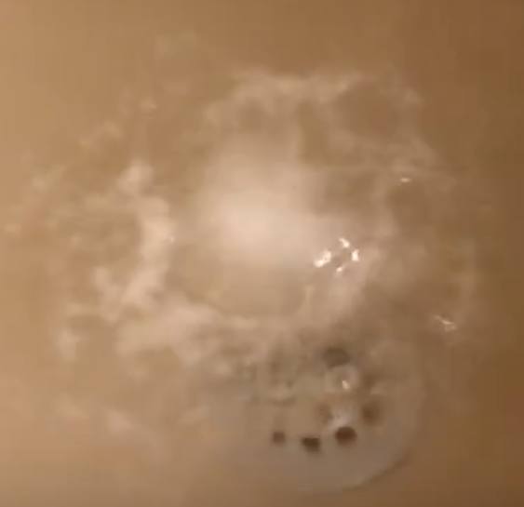
What’s next?
Slide U
We figured out that the gas in the bubbles comes from what is already there.
What exactly do you think is in a bath bomb?
How can we find out?
Notes:
Navigate to the next lesson. At the end of class, ask students if they know where the gas came from. They know it came from the starting materials, but do they know what those materials are?
Students may share several different ideas, but tell them that they will investigate the ingredients in bath bombs in the next lesson.

